Slide 1
Hash Functions and
Message Authentication Codes
Cryptography 1
September 12, 2013
Sebastiaan de Hoogh, TU/e

Slide 2
Announcements
Until this morning 50 students handed in 43 pieces of homeworks. (only 7 pairs)
BUT: Homeworks should be handed in by pairs!!!
I.E.: One solution sheet per two students.
AND: Homeworks should be mailed to crypto13@tue.nl
Individual solutions will not be corrected from week 2
  This week all homeworks will be corrected though
There will be No Exceptions
  Except for one student who is not in NL
Questions about homeworks: crypto13@tue.nl

Slide 3
how are hash functions used?
integrity protection
  strong checksum
  for file system integrity (Bit-torrent) or software downloads
one-way ‘encryption’
  for password protection
asymmetric digital signature
MAC – message authentication code
  Efficient symmetric ‘digital signature’
key derivation
pseudo-random number generation
…

Slide 4

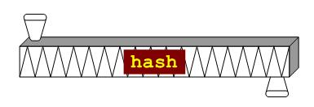
what is a hash function?
h : {0,1}* → {0,1}^{n}
(general: h : S → {0,1}^{n} for some set S)
input: bit string m of arbitrary length
  length may be 0
  in practice a very large bound on the length is imposed, such as 2⁶⁴ (≈ 2.1 million TB)
  input often called the message
output: bit string h(m) of fixed length n
  e.g. n = 128, 160, 224, 256, 384, 512
  compression
  output often called hash value, message digest, fingerprint
h(m) is easy to compute from m
no secret information, no key

Slide 5

hash collision
m₁, m₂ are a collision for h if
h(m₁) = h(m₂) while m₁ ≠ m₂
I owe you € 100
I owe you € 5000
different
documents
there exist a lot of collisions
  pigeonhole principle
  (a.k.a. Schubladensatz)
identical hash
=
collision

Slide 6
preimage
given h₀, then m is a preimage of h₀ if
h(m) = h₀
X

Slide 7

second preimage
given m₀, then m is a second preimage of m₀ if
h(m) = h(m₀ ) while m ≠ m₀
?
X

Slide 8
cryptographic hash function requirements
collision resistance: it should be computationally infeasible to find a collision m₁, m₂ for h
  i.e. h(m₁) = h(m₂)
preimage resistance: given h₀ it should be computationally infeasible to find a preimage m for h₀ under h
  i.e. h(m) = h₀
second preimage resistance: given m₀ it should be computationally infeasible to find a second preimage m for m₀ under h
  i.e. h(m) = h(m₀)

Slide 9
other terminology
one-way = preimage + second preimage resistant
  sometimes only preimage resistant
weak collision resistant = second preimage resistant
strong collison resistant = collision resistant
OWHF – one-way hash function
  preimage and second preimage resistant
CRHF – collision resistant hash function
  second preimage resistant and collision resistant

Slide 10
relations between requirements
Theorem: If h is collision resistant then it is second preimage resistant
  Proof: a second preimage is a collision.
Non-theorem: If h is second preimage resistant then it is preimage resistant
  Non-proof:
  suppose that for any h₀ one can compute a preimage m. Then, given m₀, one can certainly do that for h₀ = h(m₀).
  problem: to guarantee that m ≠ m₀
in practice:
collision resistant → second preimage resistant second preimage resistant → preimage resistant

Slide 11
pathologic counterexamples
if g : {0,1}* → {0,1}^{n} is collision resistant, then take
h(m) = 1 || m if m has length n,
h(m) = 0 || g(m) otherwise,
then h is collision resistant but not preimage resistant
the identity function id : {0,1}^{n} → {0,1}^{n} is second preimage resistant but not preimage resistant

Slide 12
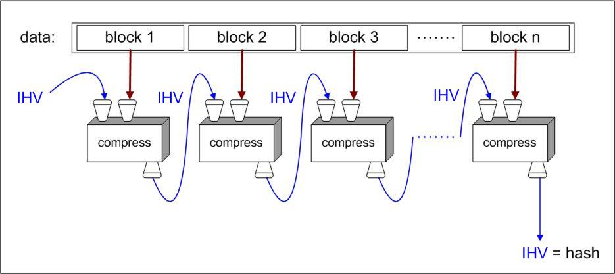
hash function design - iterated compression

Slide 13
Merkle-Damgård construction
assume that message m can be split up into blocks m₁, …, m_{s} of equal block length r
  most popular block length is r = 512
compression function: CF : {0,1}^{n} x {0,1}^{r} → {0,1}^{n}
intermediate hash values (length n) as CF input and output
message blocks as second input of CF
start with fixed initial IHV₀ (a.k.a. IV = initialization vector)
iterate CF : IHV₁ = CF(IHV₀,m₁), IHV₂ = CF(IHV₁,m₂), …, IHV_{s} = CF(IHV_{s-1},m_{s}),
take h(m) = IHV_{s} as hash value
advantages:
  this design makes streaming possible
  hash function analysis becomes compression function analysis
  analysis easier because domain of CF is finite

Slide 14
padding
padding: add dummy bits to satisfy block length requirement
non-ambiguous padding: add one 1-bit and as many 0-bits as necessary to fill the final block
  when original message length is a multiple of the block length, apply padding anyway, adding an extra dummy block
  any other non-ambiguous padding will work as well

Slide 15
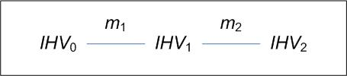
Merkle-Damgård strengthening
let padding leave final 64 bits open
encode in those 64 bits the original message length
  that’s why messages of length ≥ 2⁶⁴ are not supported
reasons:
  needed in the proof of the Merkle-Damgård theorem
  prevents some attacks such as
    trivial collisions for random IHV
      now h(IHV₀,m₁||m₂) = h(IHV₁,m₂)
    see next slide for more

Slide 16
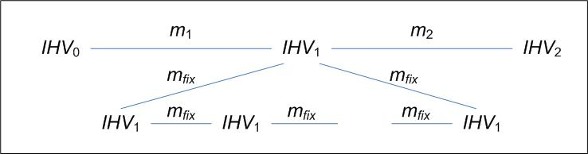
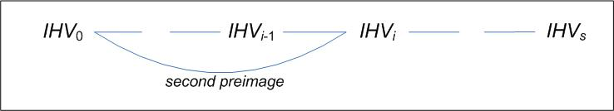
continued
    fixpoint attack
    fixpoint: IHV, m such that CF(IHV,m) = IHV
    long message attack

Slide 17
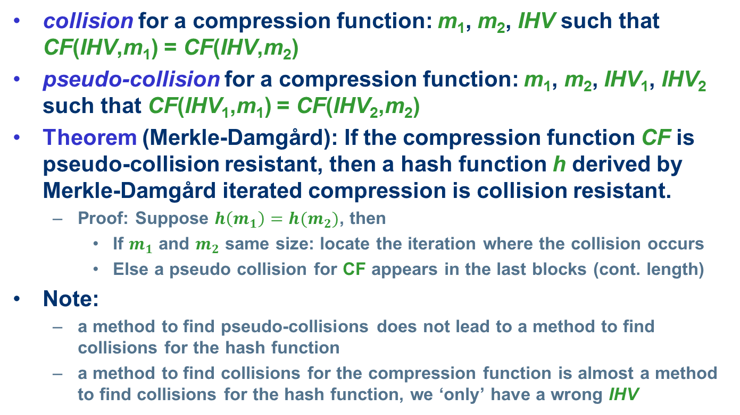
compression function collisions
collision for a compression function: m₁, m₂, IHV such that CF(IHV,m₁) = CF(IHV,m₂)
pseudo-collision for a compression function: m₁, m₂, IHV₁, IHV₂ such that CF(IHV₁,m₁) = CF(IHV₂,m₂)
Theorem (Merkle-Damgård): If the compression function CF is pseudo-collision resistant, then a hash function h derived by Merkle-Damgård iterated compression is collision resistant.
  Proof: Suppose $h\left(m_{1}\right)=h(m_{2})$, then
    If $m_{1}$ and $m_{2}$ same size: locate the iteration where the collision occurs
    Else a pseudo collision for CF appears in the last blocks (cont. length)
Note:
  a method to find pseudo-collisions does not lead to a method to find collisions for the hash function
  a method to find collisions for the compression function is almost a method to find collisions for the hash function, we ‘only’ have a wrong IHV

Slide 18
the MD4 family of hash functions
MD4
(Rivest 1990)
RIPEMD
(RIPE 1992)
SHA-0
(NIST 1993)
MD5
(Rivest 1992)
HAVAL
(Zheng, Pieprzyk, Seberry 1993)
SHA-1
(NIST 1995)
RIPEMD-128 RIPEMD-160 RIPEMD-256 RIPEMD-320
(Dobbertin, Bosselaers, Preneel 1992)
SHA-224 SHA-256 SHA-384 SHA-512
(NIST 2004)

Slide 19
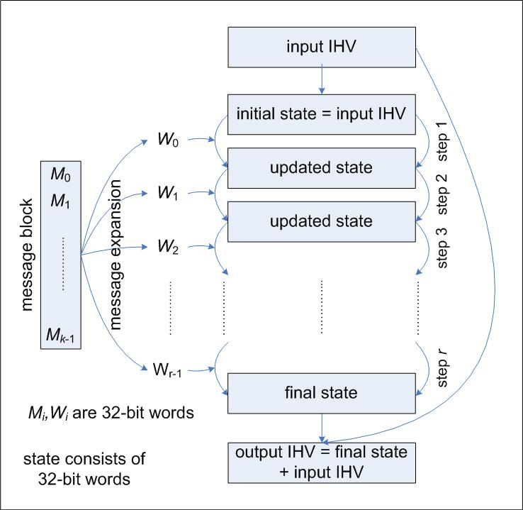
design of MD4 family compression functions
message block
split into words
message expansion
input words for each step
IHV → initial state
each step updates state with an input word
final state ‘added’ to IHV
  (feed-forward)

Slide 20
design details
MD4, MD5, SHA-0, SHA-1 details:
  512-bit message block split into 16 32-bit words
  state consists of 4 (MD4, MD5) or 5 (SHA-0, SHA-1) 32-bit words
  MD4: 3 rounds of 16 steps each, so 48 steps, 48 input words
  MD5: 4 rounds of 16 steps each, so 64 steps, 64 input words
  SHA-0, SHA-1: 4 rounds of 20 steps each, so 80 steps, 80 input words
  message expansion and step operations use only very easy to implement operations:
    bitwise Boolean operations
    bit shifts and bit rotations
    addition modulo 2³²
  proper mixing believed to be cryptographically strong

Slide 21
message expansion
MD4, MD5 use roundwise permutation, for MD5:
  W₀ = M₀, W₁ = M₁, …, W₁₅ = M₁₅,
  W₁₆ = M₁, W₁₇ = M₆, …, W₃₁ = M₁₂, (jump 5 mod 16)
  W₃₂ = M₅, W₃₃ = M₈, …, W₄₇ = M₂, (jump 3 mod 16)
  W₄₈ = M₀, W₄₉ = M₇, …, W₆₃ = M₉ (jump 7 mod 16)
SHA-0, SHA-1 use recursivity
  W₀ = M₀, W₁ = M₁, …, W₁₅ = M₁₅,
  SHA-0: W_{i} = W_{i-3} XOR W_{i-8} XOR W_{i-14} XOR W_{i-16} for i = 17, …, 80
  problem: k^{th} bit influenced only by k^{th} bits of preceding words, so not much diffusion
  SHA-1: W_{i} = (W_{i-3} XOR W_{i-8} XOR W_{i-14} XOR W_{i-16} )<<<1
  (additional rotation by 1 bit,
  this is the only difference between SHA-0 and SHA-1)

Slide 22
Example: step operations in MD5
in each step only one state word is updated
the other state words are rotated by 1
state update:
A’ = B + ((A + f_{i}(B,C,D) + W_{i} + K_{i}) <<< s_{i} )
K_{i}, s_{i} step dependent constants,
+ is addition mod 2³²,
f_{i} round dependend boolean functions:
f_{i}(x,y,z) = xy OR (¬x)z for i = 1, …, 16,
f_{i}(x,y,z) = xz OR y(¬z) for i = 17, …, 32, f_{i}(x,y,z) = x XOR y XOR z for i = 33, …, 48,
f_{i}(x,y,z) = y XOR (y OR (¬z)) for i = 49, …, 64,
these functions are nonlinear, balanced, and
have an avalanche effect

Slide 23
step operations in MD5

Slide 24
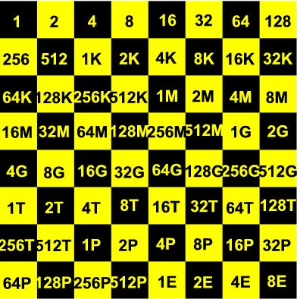
trivial (brute force) attacks
assume: hash function behaves like random function
preimages and second preimages can be found by random guessing search
  search space: ≈ n bits, ≈ 2^{n} hash function calls
collisions can be found by birthdaying
  search space: ≈ ½n bits,
  ≈ 2^{½n} hash function calls
this is a big difference
  MD5 is a 128 bit hash function
  (second) preimage random search: ≈ 2¹²⁸ ≈ 3x10³⁸ MD5 calls
  collision birthday search: only ≈ 2⁶⁴ ≈ 2x10¹⁹ MD5 calls

Slide 25
birthday paradox
birthday paradox
given a set of t (≥ 10) elements
take a sample of size k (drawn with repetition)
in order to get a probability ≥ ½ on a collision
(i.e. an element drawn at least twice)
k has to be > 1.2 √t
consequence
if F : A → B is a surjective random function
and #A >> #B
then one can expect a collision after about √(#B) random function calls

Slide 26
proof of birthday paradox
probability that all k elements are distinct is
and this is < ½ when k(k-1) > (2 log 2)t
(≈ k²) (≈ 1.4 t)

Slide 27
meaningful birthdaying
random birthdaying
  do exhaustive search on ½n bits
  messages will be ‘random’
  messages will not be ‘meaningful’
Yuval (1979)
  start with two meaningful messages m₁, m₂ for which you want to find a collision
  identify ½n independent positions where the messages can be changed at bitlevel without changing the meaning
    e.g. tab ←→ space, space ←→ newline, etc.
  do random search on those positions

Slide 28
implementing birthdaying
naïve
  store 2^{½n} possible messages for m₁ and 2^{½n} possible messages for m₂ and check all 2^{n} pairs
less naïve
  store 2^{½n} possible messages for m₁ and for each possible m₂ check whether its hash is in the list
smart: Pollard-ρ with Floyd’s cycle finding algorithm
  computational complexity still O(2^{½n})
  but only constant small storage required

Slide 29
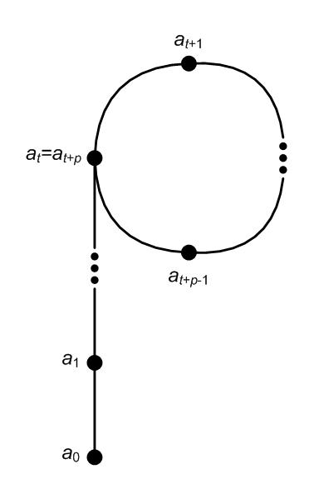
Pollard-ρ and Floyd cycle finding
Pollard-ρ
  iterate the hash function:
  a₀, a₁ = h(a₀), a₂ = h(a₁), a₃ = h(a₂), …
  this is ultimately periodic:
    there are minimal t, p such that
    a_{t+p} = a_{t}
    theory of random functions:
    both t, p are of size 2^{½n}
Floyd’s cycle finding algorithm
  Floyd: start with (a₁,a₂) and compute
  (a₂,a₄), (a₃,a₆), (a₄,a₈), …, (a_{q},a_{2q})
  until a_{2q} = a_{q};
  this happens for some q < t + p

Slide 30
security parameter
security parameter n: resistant against (brute force / random guessing) attack with search space of size 2^{n}
  complexity of an n-bit exhaustive search
  n-bit security level
nowadays 2⁸⁰ computations deemed impractical
  security parameter 80 seen as sufficient in most cases
but 2⁶⁴ computations should be about possible
  though a.f.a.i.k. nobody has done it yet
  security parameter 64 now seen as insufficient in most cases
in the future: security parameter 128 will be required
for collision resistance hash length should be 2n to reach security with parameter n

Slide 31
provable hash functions
people don’t like that one can’t prove much about hash functions
reduction to established ‘hard problem’ such as factoring is seen as an advantage
Example: VSH – Very Smooth Hash
  Contini-Lenstra-Steinfeld 2006
  collision resistance provable under assumption that a problem directly related to factoring is hard
  but still far from ideal
    bad performance compared to SHA-256
    all kinds of multiplicative relations between hash values exist

Slide 32
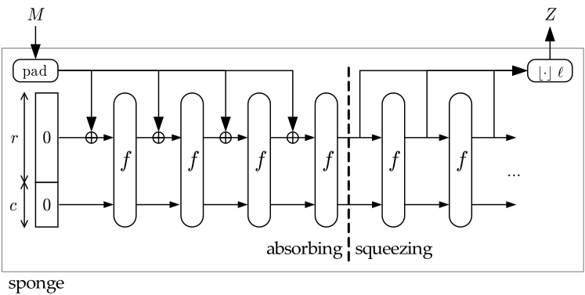
SHA-3 competition
NIST started in 2007 an open competition for a new hash function to replace SHA-256 as standard
more than 50 candidates in 1st round
Winner 2012: Keccak
  Guido Bertoni, Joan Daemen, Michaël Peeters and Gilles Van Assche
  “Family of Sponge Functions”

Slide 33
Message Authentication Codes
MACs

Slide 34
Message Authentication Codes (MACs)
Efficient Signatures based on Symmetric Keys
Used to provide:
  Integrity:
    Messages cannot be modified by (active) interceptor
  Data Origin Authenticity:
    Some data originates from the entity it is claimed to come from
Should maintain confidentiality
  Content of messages remains hidden from (passive) interceptor
Does not provide non-repudiation:
  The originator of a message cannot deny this in front of a third party. By construction, sender and receiver would generate the same MAC on a certain message.
Example applications: IPsec and SSL

Slide 35
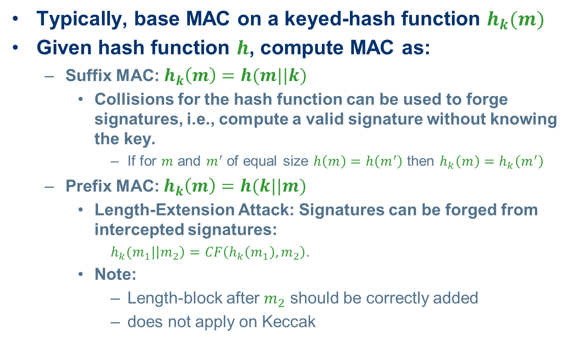
(Weak) Constructions
Typically, base MAC on a keyed-hash function $h_{k}(m)$
Given hash function $h$, compute MAC as:
  Suffix MAC: $h_{k}\left(m\right)=h(m||k)$
    Collisions for the hash function can be used to forge signatures, i.e., compute a valid signature without knowing the key.
      If for $m$ and $m^{′}$ of equal size $h\left(m\right)=h\left(m^{′}\right)$ then $h_{k}\left(m\right)=h_{k}\left(m^{′}\right)$
  Prefix MAC: $h_{k}\left(m\right)=h(k||m)$
    Length-Extension Attack: Signatures can be forged from intercepted signatures:
    $h_{k}(m_{1}|\left|m_{2}\right)=CF\left(h_{k}\left(m_{1}\right),m_{2}\right)$.
    Note:
      Length-block after $m_{2}$ should be correctly added
      does not apply on Keccak

Slide 36
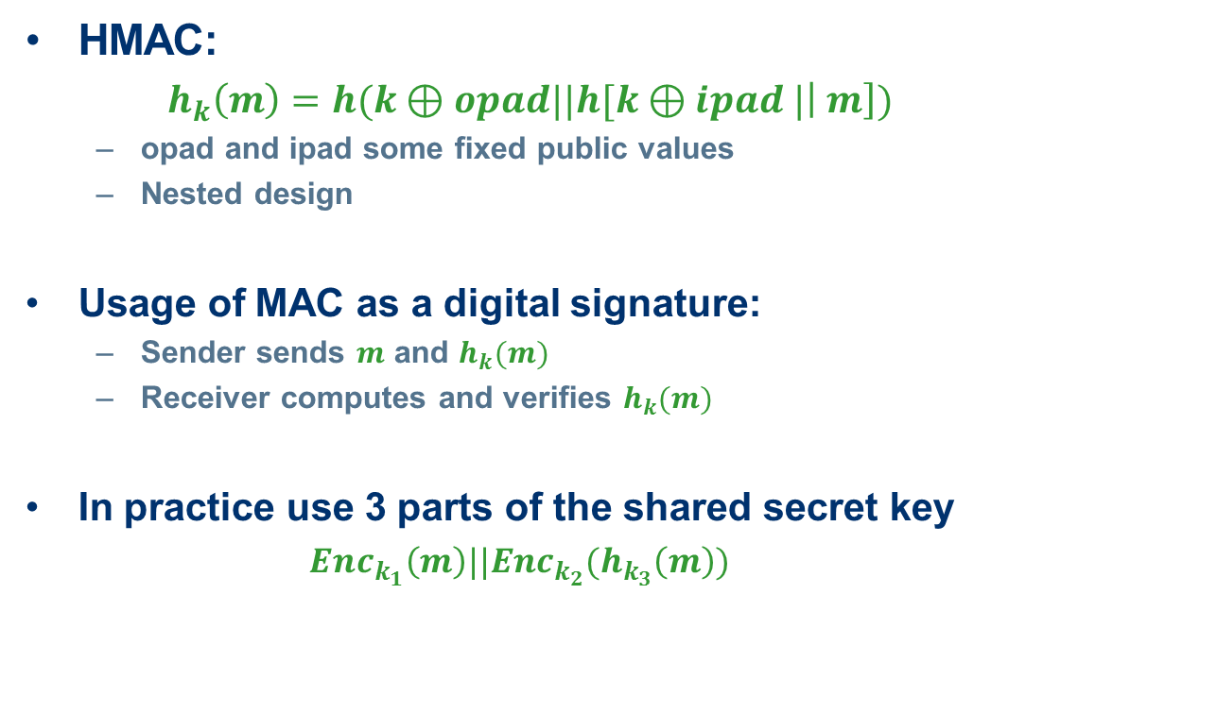
Typical construction
HMAC:
  $h_{k}\left(m\right)=h(k⊕opad||h[k⊕ipad |\left| m\right])$
  opad and ipad some fixed public values
  Nested design
Usage of MAC as a digital signature:
  Sender sends $m$ and $h_{k}(m)$
  Receiver computes and verifies $h_{k}(m)$
In practice use 3 parts of the shared secret key
  $Enc_{k_{1}}\left(m\right)||Enc_{k_{2}}(h_{k_{3}}\left(m\right))$

Slide 37
Collisions for MD5

Slide 38
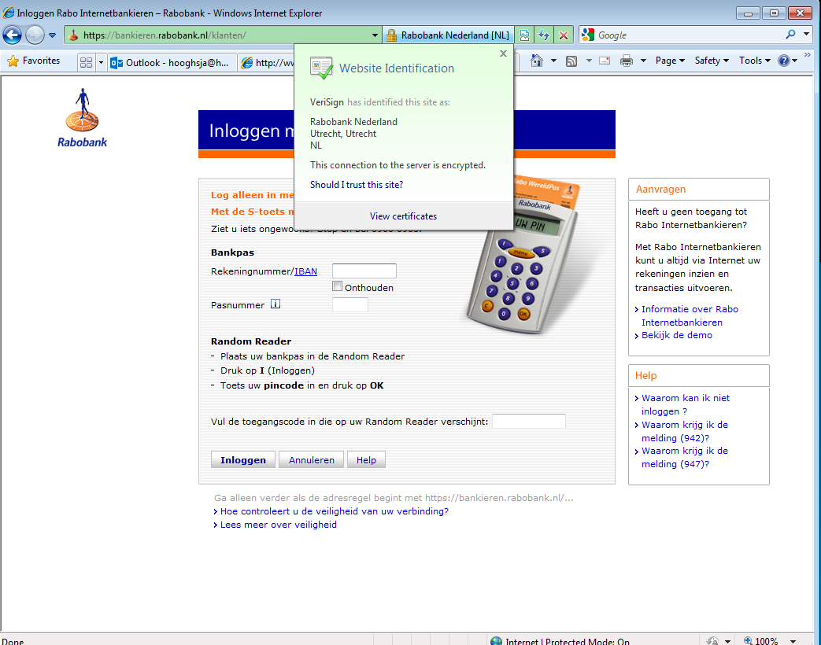
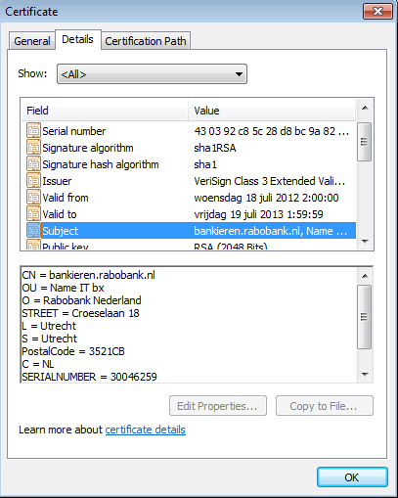
Example Hash-then-Sign in Browser

Slide 39
Wang’s attack on MD5
two-block collision
  for any input IHV, identical for the two messages
  i.e. IHV₀ = IHV₀’, ΔIHV₀ = 0
  near-collision after first block:
  IHV₁ = CF(IHV₀,m₁), IHV₁’ = CF(IHV₀,m₁’),
  with ΔIHV₁ having only a few carefully chosen ±1s
  full collision after second block:
  IHV₂ = CF(IHV₁,m₂), = CF(IHV₁’,m₂’),
  i.e. IHV₂ = IHV₂’, ΔIHV₂ = 0
with IHV₀ the standard IV for MD5, and a third block for padding and MD-strengthening, this gives a collision for the full MD5

Slide 40
chosen-prefix collisions
latest development on MD5
Marc Stevens (TU/e MSc student) 2006
  paper by Marc Stevens, Arjen Lenstra and Benne de Weger, EuroCrypt 2007
Marc Stevens (CWI PhD student) 2009
  paper by Marc Stevens, Alex Sotirov, Jacob Appelbaum, David Molnar, Dag Arne Osvik, Arjen Lenstra and Benne de Weger, Crypto 2007
  rogue CA attack

Slide 41
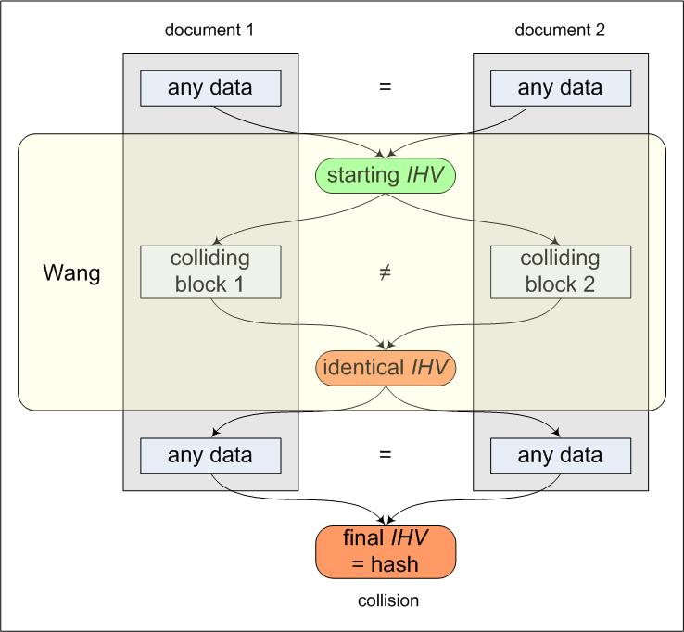
MD5: identical IV attacks
all attacks following Wang’s method, up to recently
MD5 collision attacks work for any starting IHV
  data before and after the collision can be chosen at will
but starting IHVs must be identical
  data before and after the collision must be identical
called random collision

Slide 42
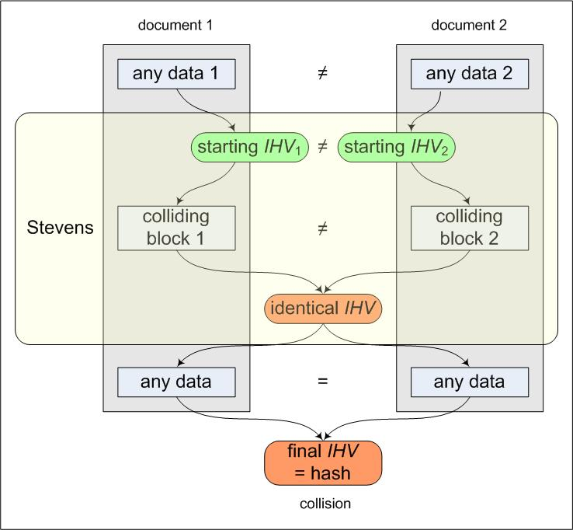
MD5: different IV attacks
new attack
  Marc Stevens, TU/e
  Oct. 2006
MD5 collisions for any starting pair {IHV₁, IHV₂}
  data before the collision needs not to be identical
  data before the collision can still be chosen at will, for each of the two documents
  data after the collision still must be identical
called chosen-prefix collision
one example produced so far (2011)

Slide 43
indeed that was not the end in 2008 the ethical hackers came by
observation: commercial certification authorities still use MD5
idea: proof of concept of realistic attack as wake up call
attack a real, commercial certification authority
purchase a web certificate for a valid web domain
but with a “little spy” built in
prepare a rogue CA certificate with identical MD5 hash
the commercial CA’s signature also holds for the rogue CA certificate

Slide 44
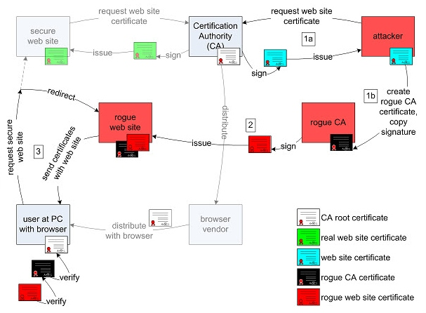
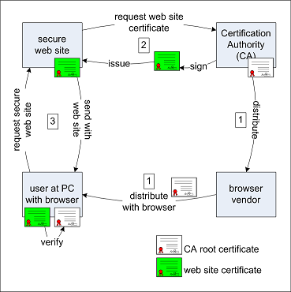
Outline of the RogueCA Attack

Slide 45
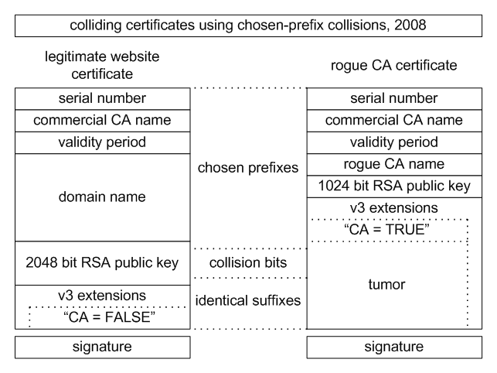
Subject = CA
Subject = End Entity

Slide 46
problems to be solved
predict the serial number
predict the time interval of validity
at the same time
a few days before
more complicated certificate structure
“Subject Type” after the public key
small space for the collision blocks
is possible but much more computations needed
not much time to do computations
to keep probability of prediction success reasonable

Slide 47
how difficult is predicting?
time interval:
CA uses automated certification procedure
certificate issued exactly 6 seconds after click
serial number :
  Nov 3 07:44:08 2008 GMT 643006
  Nov 3 07:45:02 2008 GMT 643007
  Nov 3 07:46:02 2008 GMT 643008
  Nov 3 07:47:03 2008 GMT 643009
  Nov 3 07:48:02 2008 GMT 643010
  Nov 3 07:49:02 2008 GMT 643011
  Nov 3 07:50:02 2008 GMT 643012
  Nov 3 07:51:12 2008 GMT 643013
  Nov 3 07:51:29 2008 GMT 643014
  Nov 3 07:52:02 2008 GMT have a guess…

Slide 48
the attack at work
estimated: 800-1000 certificates issued in a weekend
procedure:
  buy certificate on Friday, serial number S-1000
  predict serial number S for time T Sunday evening
  make collision for serial number S and time T: 2 days time
  short before T buy additional certificates until S-1
  buy certificate on time T-6
  hope that nobody comes in between and steals our serial number S

Slide 49
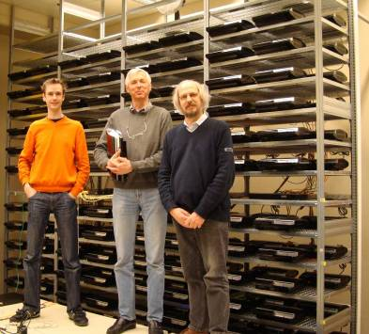
to let it work
cluster of >200
PlayStation3
game consoles
(1 PS3 = 40 PC’s)
complexity: 2⁵⁰
memory: 30 GB
→ collision in 1 day

Slide 50
result
success after 4th attempt (4th weekend)
purchased a few hundred certificates
(promotion action: 20 for one price)
total cost: < US$ 1000

Slide 51
conclusion on collisions
at this moment, ‘meaningful’ hash collisions are
  easy to make
  but also easy to detect
  still hard to abuse realistically
with chosen-prefix collisions we come close to realistic attacks
to do real harm, second pre-image attack needed
  real harm is e.g. forging digital signatures
  this is not possible yet, not even with MD5
More information: http://www.win.tue.nl/hashclash/

