Slide 1
Slides accompanying 2WC12
Sebastiaan de Hoogh

Slide 2
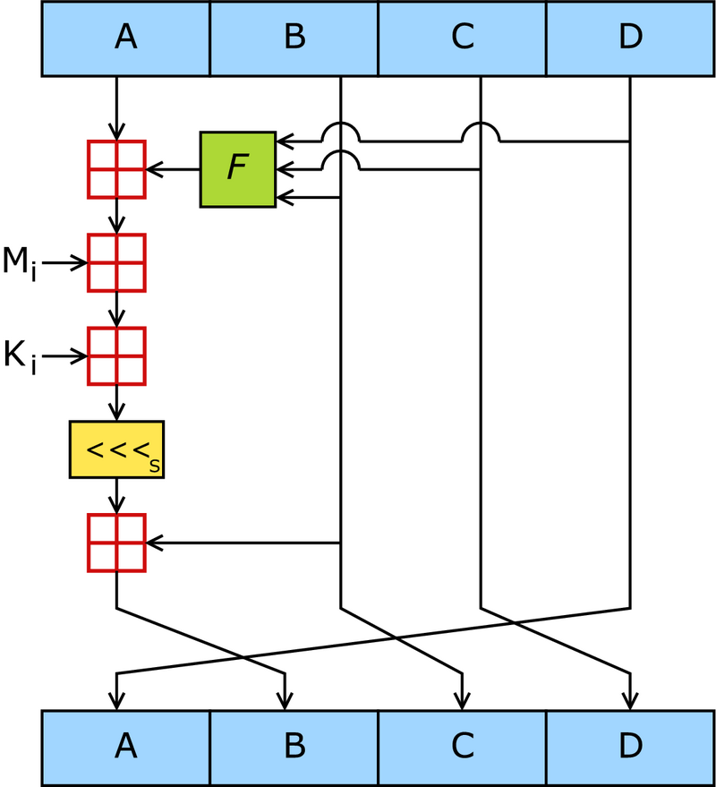
MD5 Compression function

Slide 3
Extra slides, if time permits

Slide 4
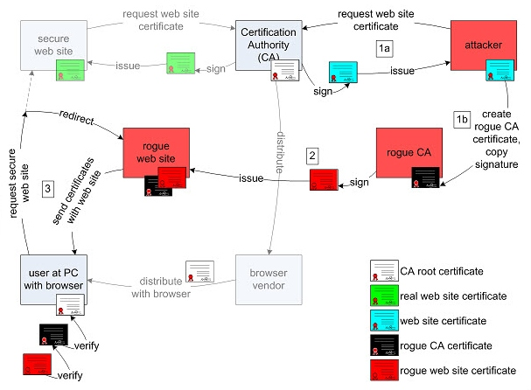
MD5 considered Harmful today
Source: http://www.win.tue.nl/hashclash/rogue-ca/

Slide 5
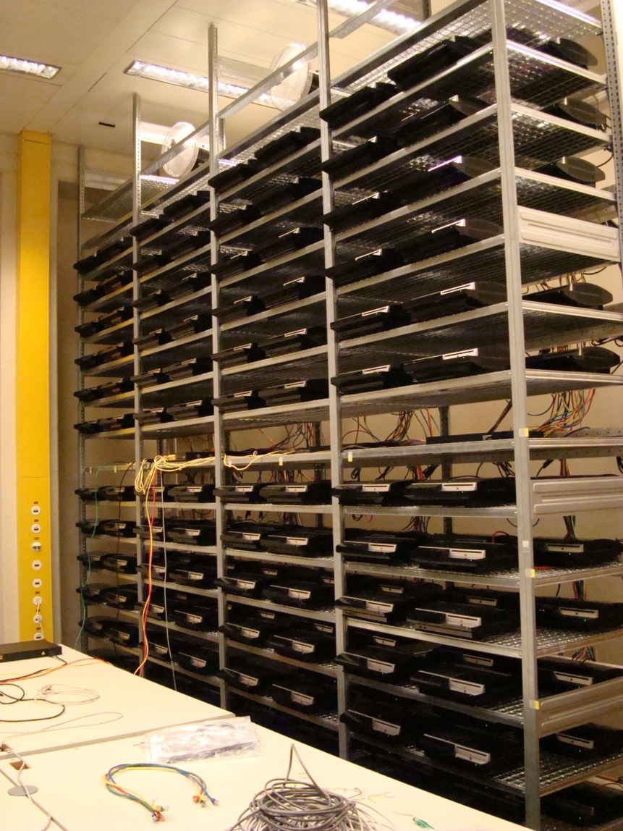
Computing Recources:
”Playstation Lab”
“The birthdaying takes about 18 hours on the 200 PS3s using 30GB of memory that was equally divided over the PS3s”

