Slide 1
Cryptographic Hash Functions
Part II
2MMC10 Cryptology
Andreas Hülsing, TU/e

Slide 2
Hash function design
Create fixed input size building block
Use building block to build compression function
Use “mode“ for length extension
Permutation / Block cipher
Compression function
Hash function
Engineering
Generic transforms
Cryptanalysis /
best practices
Reductionist proofs

Slide 3
(Length-Extension) Modes

Slide 4

Merkle-Damgård construction
Given:
compression function: $CF : \left\{0,1\right\}n× \{0,1\}r→\{0,1\}n$
Goal:
Hash function: $h: {\left\{0,1\right\}}^{∗}→ \{0,1\}n$

Slide 5
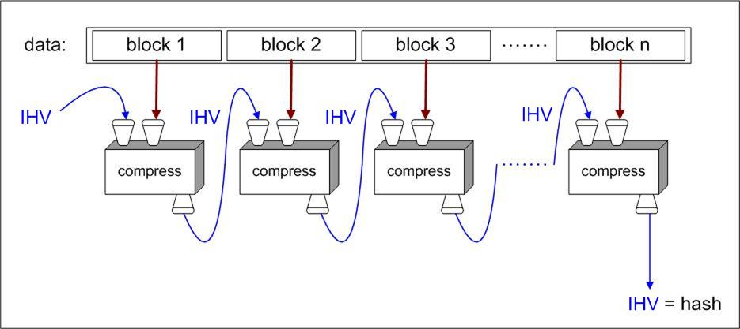
Merkle-Damgård - iterated compression

Slide 6
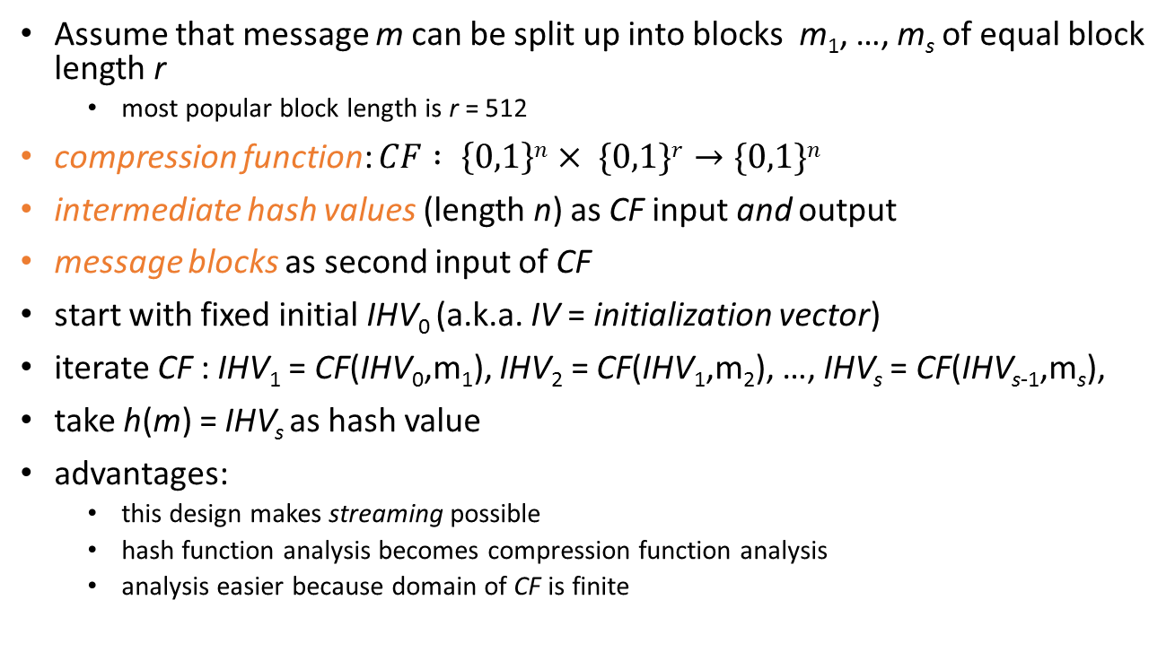
Merkle-Damgård construction
Assume that message m can be split up into blocks m₁, …, m_{s} of equal block length r
  most popular block length is r = 512
compression function: $CF : \left\{0,1\right\}n× \{0,1\}r→\{0,1\}n$
intermediate hash values (length n) as CF input and output
message blocks as second input of CF
start with fixed initial IHV₀ (a.k.a. IV = initialization vector)
iterate CF : IHV₁ = CF(IHV₀,m₁), IHV₂ = CF(IHV₁,m₂), …, IHV_{s} = CF(IHV_{s-1},m_{s}),
take h(m) = IHV_{s} as hash value
advantages:
  this design makes streaming possible
  hash function analysis becomes compression function analysis
  analysis easier because domain of CF is finite

Slide 7
padding
padding: add dummy bits to satisfy block length requirement
non-ambiguous padding: add one 1-bit and as many 0-bits as necessary to fill the final block
  when original message length is a multiple of the block length, apply padding anyway, adding an extra dummy block
  any other non-ambiguous padding will work as well

Slide 8
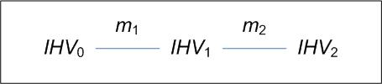
Merkle-Damgård strengthening
let padding leave final 64 bits open
encode in those 64 bits the original message length
  that’s why messages of length ≥ 2⁶⁴ are not supported
reasons:
  needed in the proof of the Merkle-Damgård theorem
  prevents some attacks such as
    trivial collisions for random IV
      now h(IHV₀,m₁||m₂) = h(IHV₁,m₂)
    see next slide for more

Slide 9
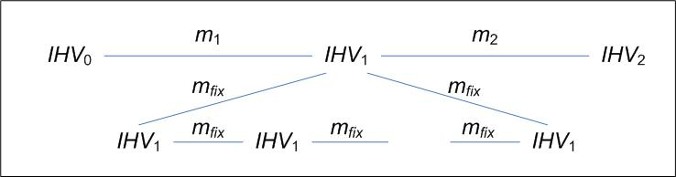
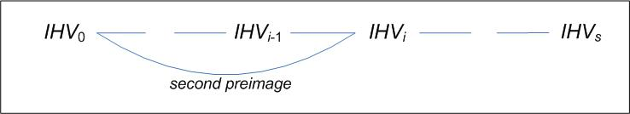
Merkle-Damgård strengthening, cont’d
    fixpoint attack
    fixpoint: IHV, m such that CF(IHV,m) = IHV
    long message attack
Notes:
Allows to find 2nd preimage in birthday time...

Slide 10
compression function collisions
collision for a compression function: m₁, m₂, IHV such that CF(IHV,m₁) = CF(IHV,m₂)
pseudo-collision for a compression function: m₁, m₂, IHV₁, IHV₂ such that CF(IHV₁,m₁) = CF(IHV₂,m₂)
Theorem (Merkle-Damgård): If the compression function CF is pseudo-collision resistant, then a hash function h derived by Merkle-Damgård iterated compression is collision resistant.
  Proof: Suppose $h\left(m_{1}\right)=h(m_{2})$, then
    If $m_{1},$ $m_{2}$ same size: locate the iteration where pseudo-collision occurs
    Else a pseudo-collision for CF appears in the last blocks (cont. length)
Note:
  a method to find pseudo-collisions does not lead to a method to find collisions for the hash function
  a method to find collisions for the compression function is almost a method to find collisions for the hash function, we ‘only’ have a wrong IHV

Slide 11
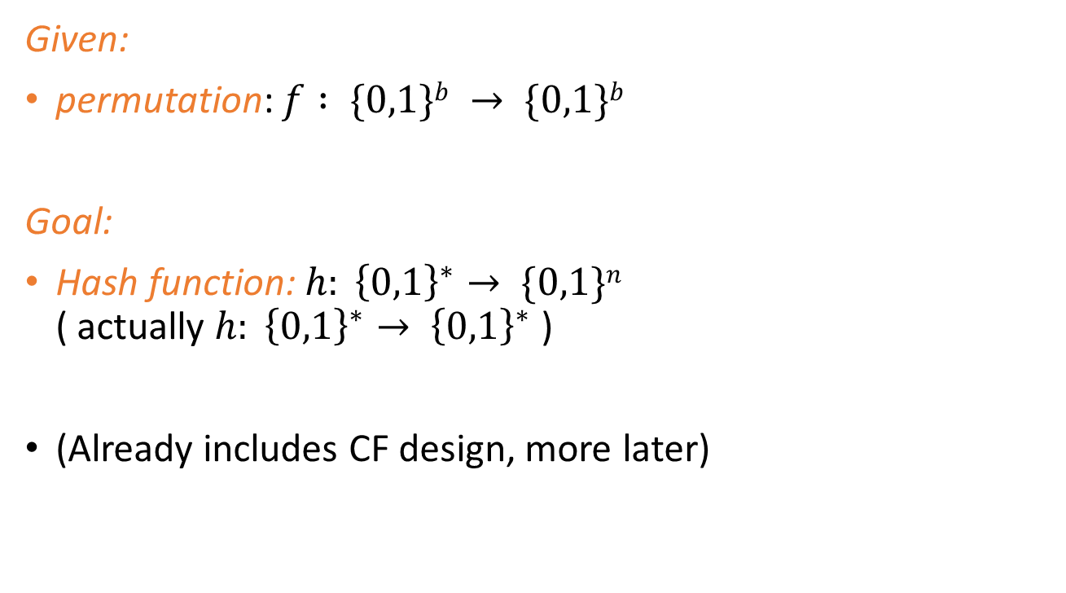
Sponges
Given:
permutation: $f : \{0,1\}b → \{0,1\}b$
Goal:
Hash function:$h: {\left\{0,1\right\}}^{∗}→ \{0,1\}n$
( actually $h: {\left\{0,1\right\}}^{∗}→ {\left\{0,1\right\}}^{∗}$ )
(Already includes CF design, more later)

Slide 12
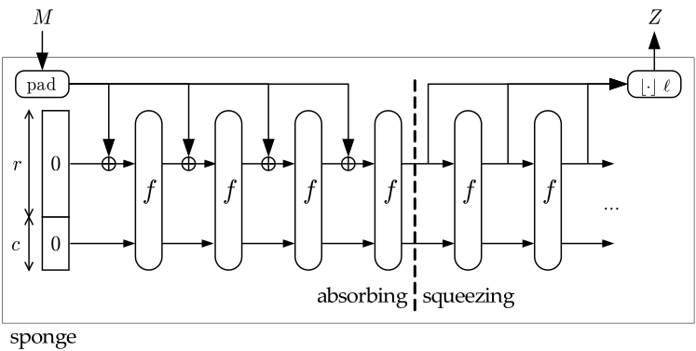
Sponges
Used and introduced in SHA3 aka Keccak
  Guido Bertoni, Joan Daemen, Michaël Peeters and Gilles Van Assche

Slide 13
Intermezzo: Random oracles
Models the perfect hash function
Truely random function without any structure
Best attacks: Generic attacks (No structure available!)
Issue:
No way to build a RO with polynomial-size description
Mind Model:
Lazy-sampling
  Imagine a black box implementing the function
  For every new query, a random response is sampled
  For old queries, former response is used

Slide 14
Sponge security
Theorem (Indifferentiability from a random oracle):
If f is a random permutation, the expected complexity for differentiating a sponge from a random oracle is $\sqrt{π }2^{c/2}$.
Note:
  Neat way to simplify security arguments
  Implies bounds for all attacks that use less than $\sqrt{π }2^{c/2}$ queries
  Bounds are those of generic attacks against a random oracle

Slide 15
Sponges
Used and introduced in SHA3 aka Keccak
  Guido Bertoni, Joan Daemen, Michaël Peeters and Gilles Van Assche

Slide 16
Compression Function Design

Slide 17
Block-Cipher-based designs
Traditional approach
Many possible modes
  see Preneel, Govaerts, Vandewalle. Hash functions based on block ciphers: a synthetic approach. CRYPTO’93
  security: Black, Rogaway, Shrimpton. Black-Box Analysis of the Block-Cipher-Based Hash-Function Constructions from PGV. CRYPTO’02
Most popular: Matyas-Meyer-Oseas
M_{i}
IHV_{i}
IHV_{i+1}

Slide 18
Permutation-based designs
Less frequent use
Keccak compression function:
Important: NEVER hand out last c bits of IHV!
M_{i}
r
IHV_{i}
IHV_{i+1}
c

Slide 19
Common security assessment
Provable security analyzed in idealized models:
  „Black-box models“ (e.g. ideal cipher, random oracle, or random permutation model)
Proofs assuming underlying building block behaves like such an idealized building block
Building blocks then get cryptanalyzed, searching for “non-random behavior”

Slide 20
Provable hash functions
people don’t like that one can’t prove much about hash functions
reduction to established ‘hard problem’ such as factoring is seen as an advantage
Example: VSH – Very Smooth Hash
  Contini-Lenstra-Steinfeld 2006
  collision resistance provable under assumption that a problem directly related to factoring is hard
  but still far from ideal
    bad performance compared to SHA-256
    all kinds of multiplicative relations between hash values exist

Slide 21
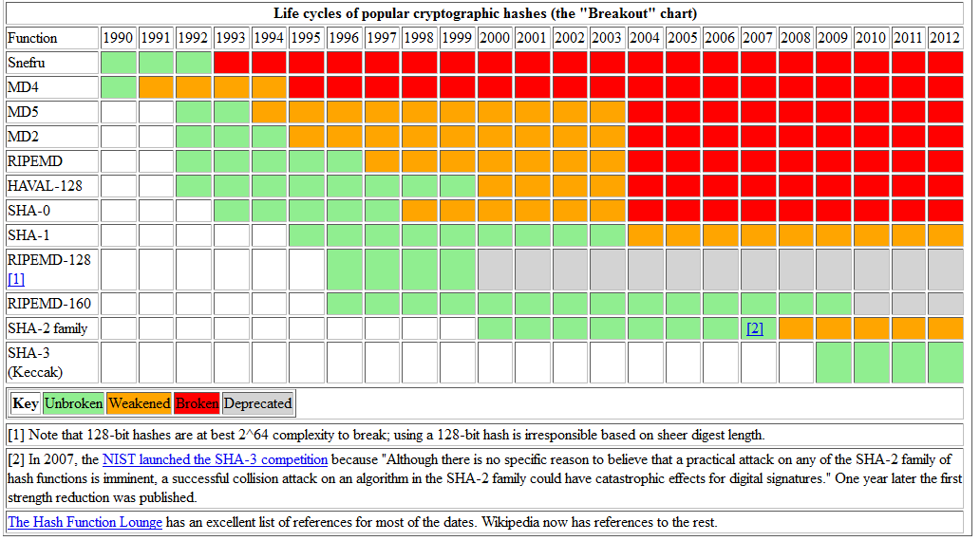

Slide 22
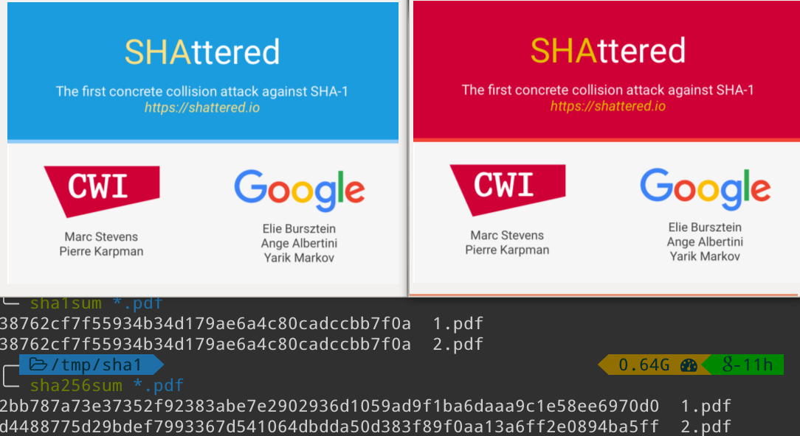

Slide 23
Hash-based signatures

Slide 24
Lamport-Diffie OTS [Lam79]
Message M = b1,…,bm, OWF H = n bit
SK
PK
Sig
*
sk_{1,0}
sk_{1,1}
sk_{m,0}
sk_{m,1}
H
H
H
H
H
H
pk_{1,0}
pk_{1,1}
pk_{m,0}
pk_{m,1}
b1
Mux
b2
Mux
bm
Mux
sk_{1,b1}
sk_{m,bm}

Slide 25
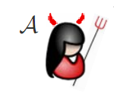





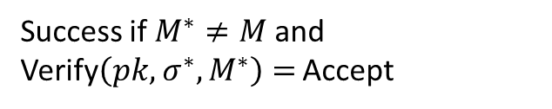
EU-CMA for OTS
$$pk,1^{n}$$
$$sk$$
$$M$$
SIGN
$$(σ,M)$$
$$(σ^{∗},M^{∗})$$
Success if $M^{∗}≠M$and Verify$\left(pk, σ^{∗},M^{∗}\right)=$ Accept

Slide 26
Security
Theorem:
If H is one-way then LD-OTS is one-time eu-cma-secure.

Slide 27


Reduction
Input: $y_{c},k$
Set $H←h_{k}$
Replace random pk_{i,b}
sk_{1,0}
sk_{1,1}
sk_{m,0}
sk_{m,1}
H
H
H
H
H
H
pk_{1,0}
pk_{1,1}
$$y_{c}$$
pk_{m,0}
pk_{m,1}

Slide 28

Reduction
Adv. Message: M = b1,…,bm
If bi = b return fail
else return Sign(M)
Input: $y_{c},k$
Set $H←h_{k}$
Replace random pk_{i,b}
sk_{1,0}
sk_{1,1}
?
sk_{m,0}
sk_{m,1}
H
H
H
H
H
pk_{1,0}
pk_{1,1}
$$y_{c}$$
pk_{m,0}
pk_{m,1}
b1
Mux
b2
Mux
bm
Mux
sk_{1,b1}
sk_{m,bm}

Slide 29



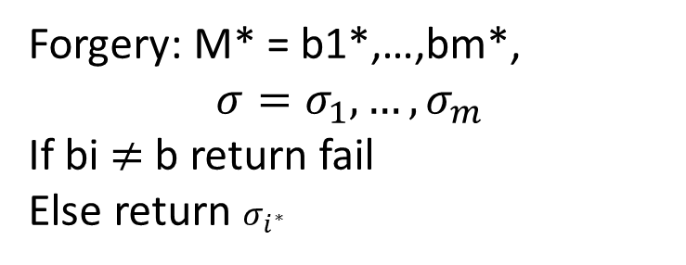
Reduction
Forgery: M* = b1*,…,bm*,
$$σ=σ_{1},…,σ_{m}$$
If bi $≠$ b return fail
Else return $σ_{i^{∗}}$
Input: $y_{c},k$
Set $H←h_{k}$
Choose random pk_{i,b}
?
sk_{1,0}
sk_{1,1}
$$σ_{i^{∗}}$$
$$σ_{i^{∗}}$$
sk_{m,0}
sk_{m,1}
H
H
H
H
H
pk_{1,0}
pk_{1,1}
$$y_{c}$$
pk_{m,0}
pk_{m,1}

Slide 30
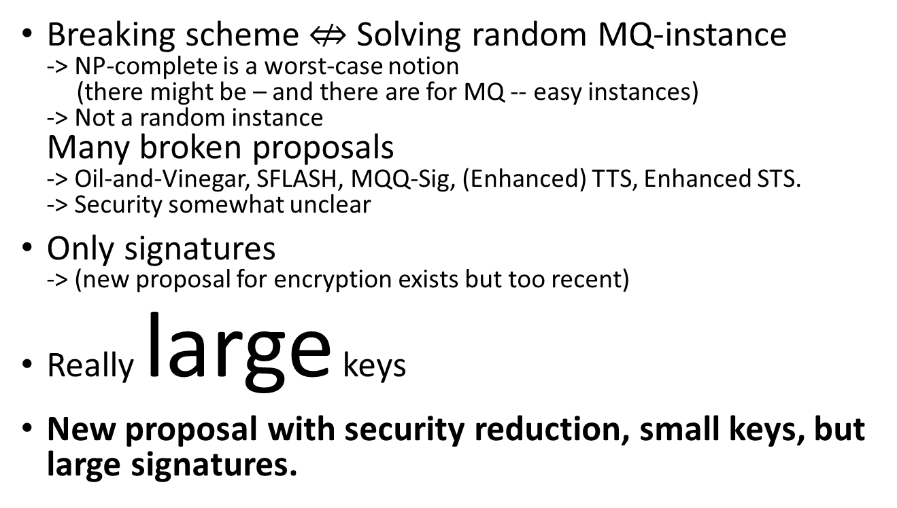
Reduction - Analysis
Abort in two cases:
1. bi = b
probability ½ : b is a random bit
2. bi $≠$ b
probability 1 - 1/m: At least one bit has to flip as M* $≠$ M
Reduction succeeds with A‘s success probability times 1/2m.

Slide 31




Merkle’s Hash-based Signatures
PK
SIG = (i=2, , , , , )
H
OTS
H
H
H
H
H
H
H
H
H
H
H
H
H
H
OTS
OTS
OTS
OTS
OTS
OTS
OTS
OTS
SK

Slide 32
Security
Theorem:
MSS is eu-cma-secure if OTS is a one-time eu-cma secure signature scheme and H is a random element from a family of collision resistant hash functions.

Slide 33
Questions?

Slide 34
Basic Building Blocks

Slide 35
the MD4 family of hash functions
MD4
(Rivest 1990)
RIPEMD
(RIPE 1992)
SHA-0
(NIST 1993)
MD5
(Rivest 1992)
HAVAL
(Zheng, Pieprzyk, Seberry 1993)
SHA-1
(NIST 1995)
RIPEMD-128 RIPEMD-160 RIPEMD-256 RIPEMD-320
(Dobbertin, Bosselaers, Preneel 1992)
SHA-224 SHA-256 SHA-384 SHA-512
(NIST 2004)

Slide 36
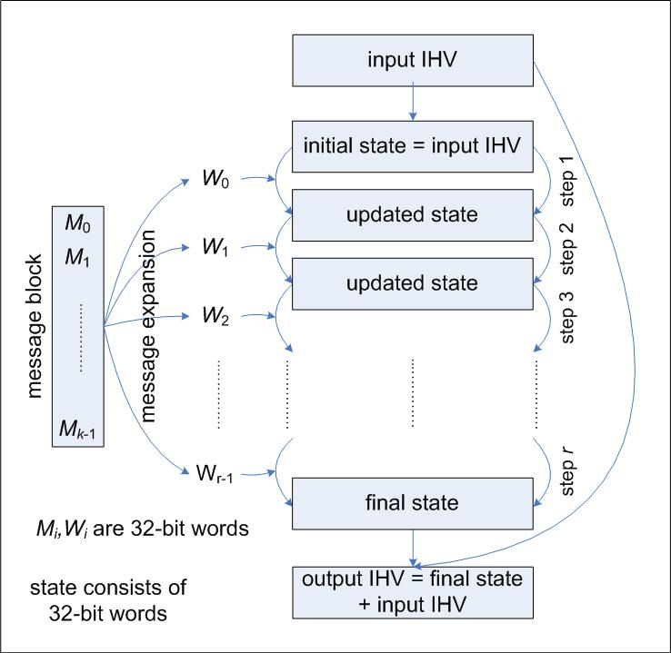
design of MD4 family compression functions
message block
split into words
message expansion
input words for each step
IHV → initial state
each step updates state with an input word
final state ‘added’ to IHV
  (feed-forward)

Slide 37
design details
MD4, MD5, SHA-0, SHA-1 details:
  512-bit message block split into 16 32-bit words
  state consists of 4 (MD4, MD5) or 5 (SHA-0, SHA-1) 32-bit words
  MD4: 3 rounds of 16 steps each, so 48 steps, 48 input words
  MD5: 4 rounds of 16 steps each, so 64 steps, 64 input words
  SHA-0, SHA-1: 4 rounds of 20 steps each, so 80 steps, 80 input words
  message expansion and step operations use only very easy to implement operations:
    bitwise Boolean operations
    bit shifts and bit rotations
    addition modulo 2³²
  proper mixing believed to be cryptographically strong

Slide 38
message expansion
MD4, MD5 use roundwise permutation, for MD5:
  W₀ = M₀, W₁ = M₁, …, W₁₅ = M₁₅,
  W₁₆ = M₁, W₁₇ = M₆, …, W₃₁ = M₁₂, (jump 5 mod 16)
  W₃₂ = M₅, W₃₃ = M₈, …, W₄₇ = M₂, (jump 3 mod 16)
  W₄₈ = M₀, W₄₉ = M₇, …, W₆₃ = M₉ (jump 7 mod 16)
SHA-0, SHA-1 use recursivity
  W₀ = M₀, W₁ = M₁, …, W₁₅ = M₁₅,
  SHA-0: W_{i} = W_{i-3} XOR W_{i-8} XOR W_{i-14} XOR W_{i-16} for i = 16, …, 79
  problem: k^{th} bit influenced only by k^{th} bits of preceding words, so not much diffusion
  SHA-1: W_{i} = (W_{i-3} XOR W_{i-8} XOR W_{i-14} XOR W_{i-16} )<<<1
  (additional rotation by 1 bit,
  this is the only difference between SHA-0 and SHA-1)

Slide 39
Example: step operations in MD5
in each step only one state word is updated
the other state words are rotated by 1
state update:
A’ = B + ((A + f_{i}(B,C,D) + W_{i} + K_{i}) <<< s_{i} )
K_{i}, s_{i} step dependent constants,
+ is addition mod 2³²,
f_{i} round dependend boolean functions:
f_{i}(x,y,z) = xy OR (¬x)z for i = 1, …, 16,
f_{i}(x,y,z) = xz OR y(¬z) for i = 17, …, 32,
f_{i}(x,y,z) = x XOR y XOR z for i = 33, …, 48,
f_{i}(x,y,z) = y XOR (y OR (¬z)) for i = 49, …, 64,
these functions are nonlinear, balanced, and
have an avalanche effect

Slide 40
Step operations in MD5

