Slide 1
Cryptographic Hash Functions
Part I
2MMC10 Cryptology
Andreas Hülsing

Slide 2
How are hash functions used?
integrity protection
  cryptographic checksum (e.g. software downloads)
  for file system integrity (Bit-torrent, git)
password hashing
  dedicated algorithms like scrypt / argon2 use hash functions as building block
MAC – message authentication codes
Digital signature (“public key MAC”)
Password-based key derivation
Pseudo-random number generation (PRG)
…

Slide 3

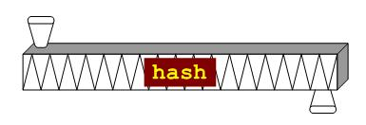
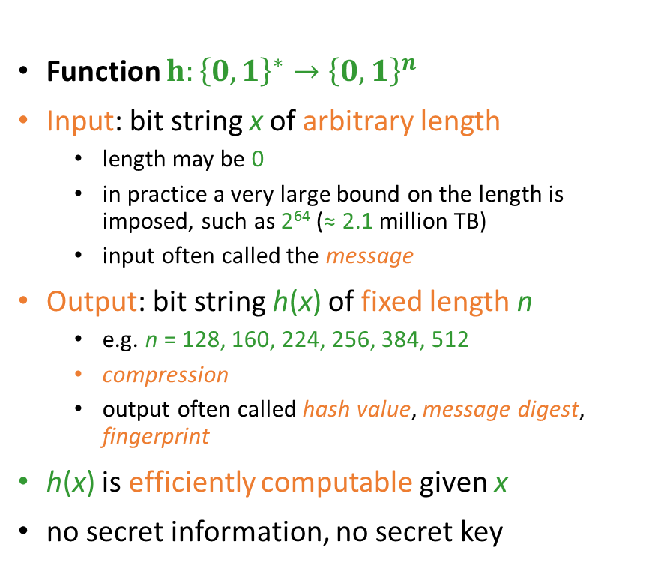
What is a hash function?
- Applied answer
Function $h:{\left\{0,1\right\}}^{∗}→{\left\{0,1\right\}}^{n}$
Input: bit string x of arbitrary length
  length may be 0
  in practice a very large bound on the length is imposed, such as 2⁶⁴ (≈ 2.1 million TB)
  input often called the message
Output: bit string h(x) of fixed length n
  e.g. n = 128, 160, 224, 256, 384, 512
  compression
  output often called hash value, message digest, fingerprint
h(x) is efficiently computable given x
no secret information, no secret key

Slide 4
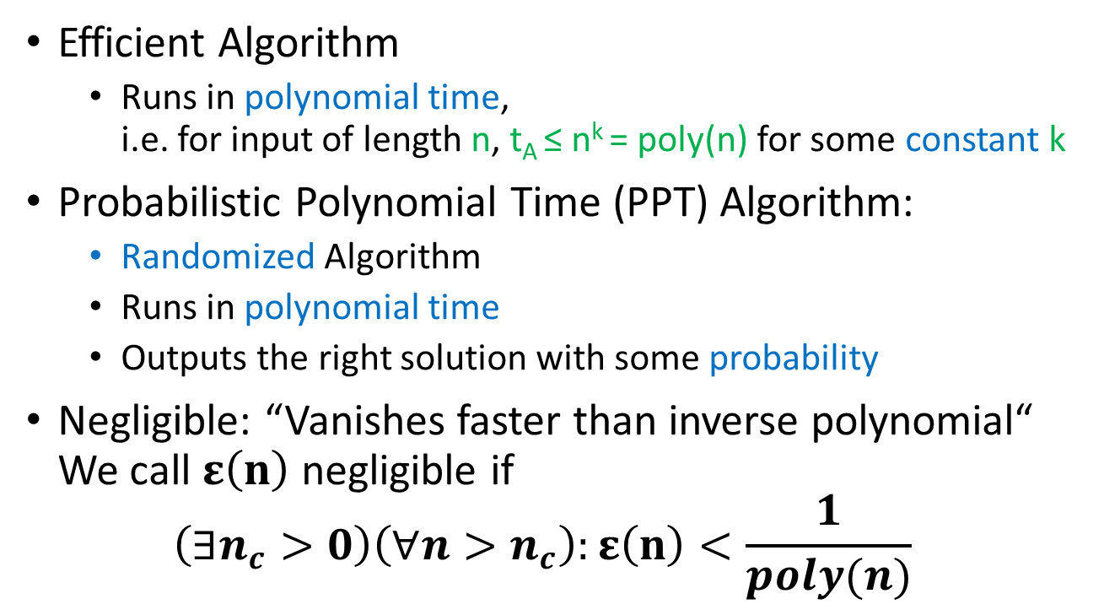
Intermezzo: Formal treatment
Efficient Algorithm
  Runs in polynomial time,
  i.e. for input of length n, t_{A} ≤ n^{k} = poly(n) for some constant k
Probabilistic Polynomial Time (PPT) Algorithm:
  Randomized Algorithm
  Runs in polynomial time
  Outputs the right solution with some probability
Negligible: “Vanishes faster than inverse polynomial“
We call $ε\left(n\right)$negligible if
$\left(∃n_{c}>0\right)\left(∀n>n_{c}\right):ε\left(n\right)<\frac{1}{poly(n)}$

Slide 5
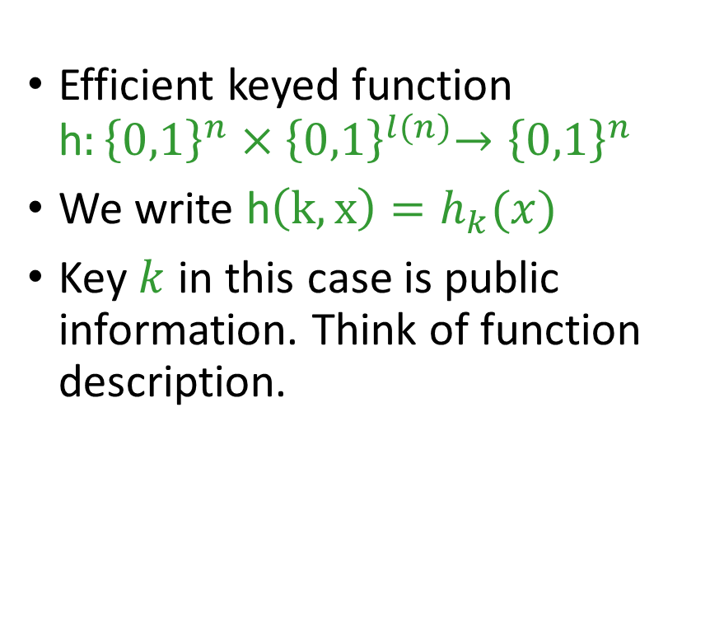
What is a hash function?
- Formal answer
Efficient keyed function
h$:{\left\{0,1\right\}}^{n}{×\left\{0,1\right\}}^{l(n)}→{\left\{0,1\right\}}^{n}$
We write h$\left(k,x\right)=h_{k}(x)$
Key $k$ in this case is public information. Think of function description.

Slide 6
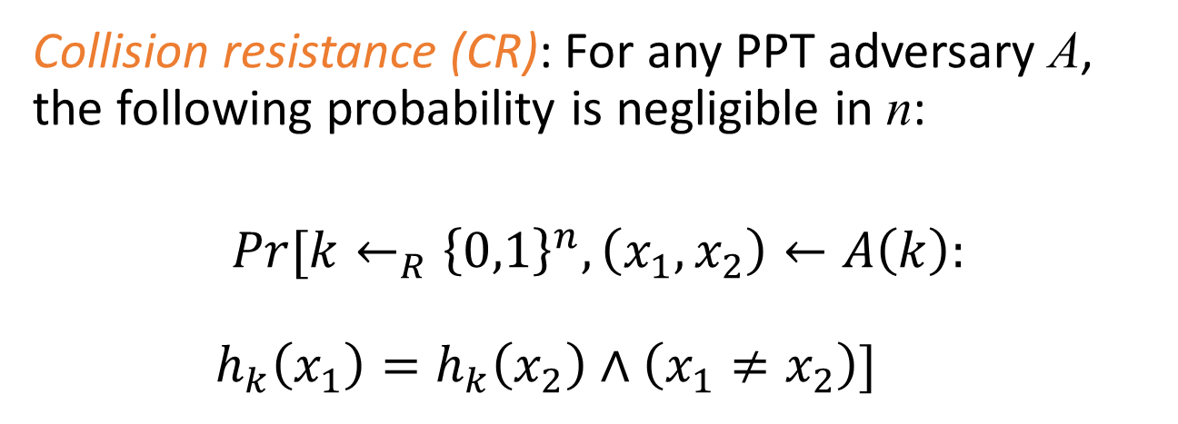
Security properties:
Collision resistance
Collision resistance (CR): For any PPT adversary A, the following probability is negligible in n:
$$Pr[k←_{R}{\left\{0,1\right\}}^{n},\left(x_{1},x_{2}\right)←A\left(k\right):$$
$h_{k}\left(x_{1}\right)=h_{k}\left(x_{2}\right)∧\left(x_{1}≠x_{2}\right)]$

Slide 7
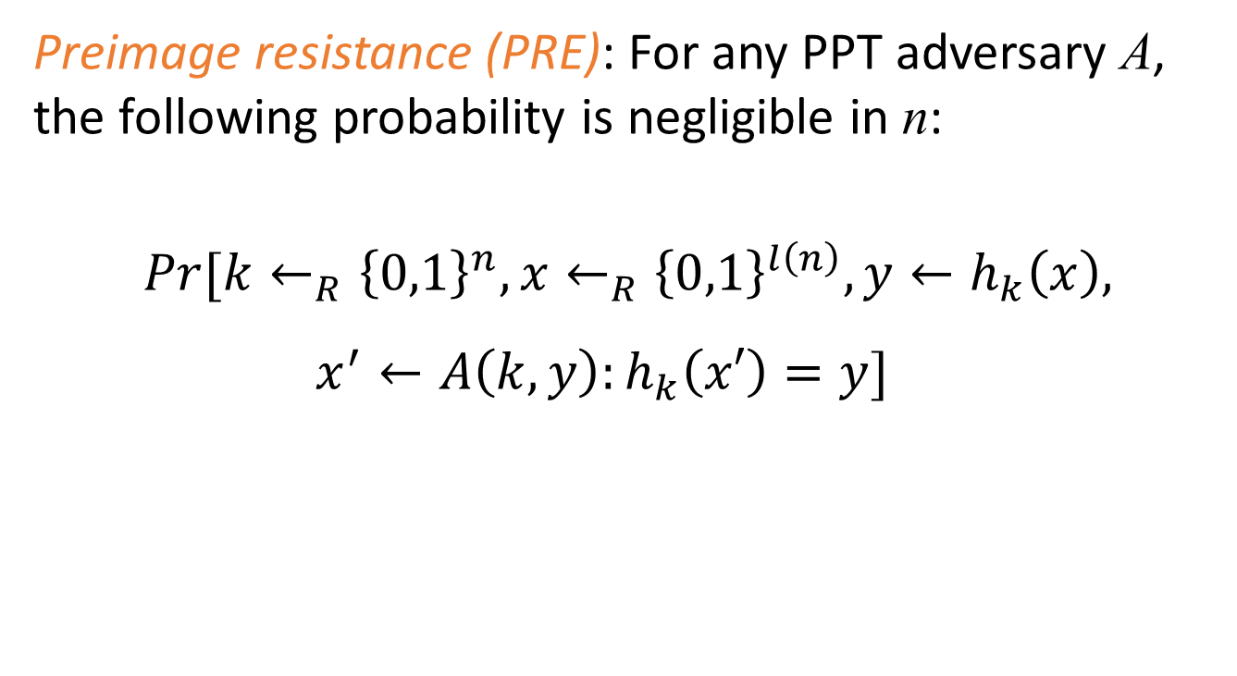
Security properties:
Preimage resistance / One-wayness
Preimage resistance (PRE): For any PPT adversary A, the following probability is negligible in n:
$$Pr[k←_{R}{\left\{0,1\right\}}^{n},x←_{R}{\left\{0,1\right\}}^{l\left(n\right)},y←h_{k}\left(x\right),$$
$x^{′}←A\left(k,y\right):h_{k}\left(x′\right)=y]$

Slide 8
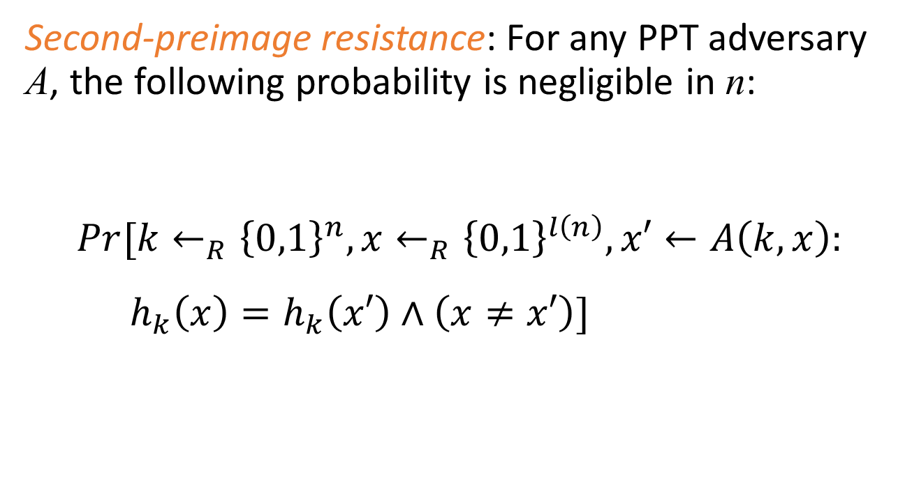
Formal security properties:
Second-preimage resistance
Second-preimage resistance: For any PPT adversary A, the following probability is negligible in n:
$$Pr[k←_{R}{\left\{0,1\right\}}^{n},x←_{R}{\left\{0,1\right\}}^{l\left(n\right)},x′←A\left(k,x\right):$$
$h_{k}\left(x\right)=h_{k}\left(x′\right)∧\left(x≠x′\right)]$

Slide 9
Reductions
Transform an algorithm for problem 1 into an algorithm for problem 2.
“Reduces problem 2 to problem 1“
(I can solve problem 2 by solving problem 1)
Allows to relate the hardness of problems:
If there exists an efficient reduction that reduces problem 2 to problem 1 then an efficient algorithm solving problem 1 can be used to efficiently solve problem 2.

Slide 10
Reductions II
Use in cryptography:
Relate security properties
„Provable Security“: Reduce an assumed to be hard problem to breaking the security of your scheme.
Actually this does not proof security! Only shows that scheme is secure IF the problem is hard.
(Intuition: It shows, I can solve my problem by breaking the security of the scheme)

Slide 11
Relations between hash function security properties

Slide 12
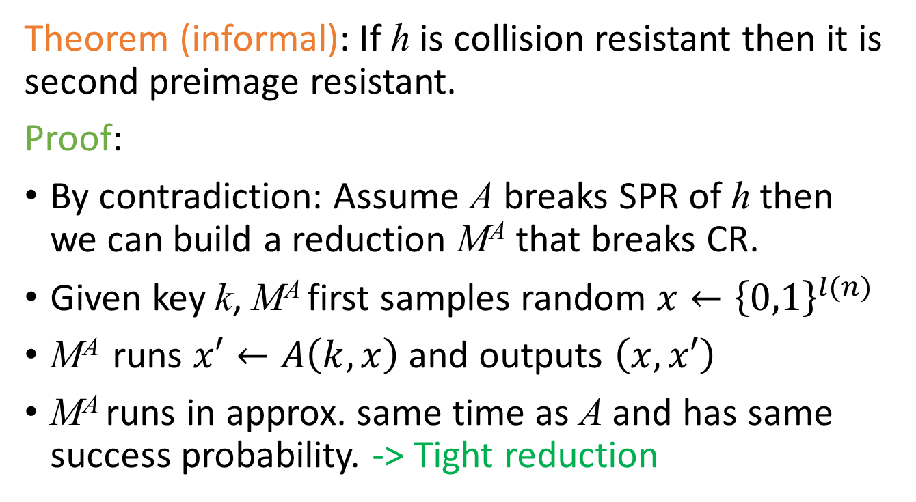
Easy start: CR -> SPR
Theorem (informal): If h is collision resistant then it is second preimage resistant.
Proof:
By contradiction: Assume A breaks SPR of h then we can build a reduction M^{A} that breaks CR.
Given key k, M^{A} first samples random $x←{\left\{0,1\right\}}^{l(n)}$
M^{A} runs $x′←A\left(k,x\right)$ and outputs $\left(x,x′\right)$
M^{A} runs in approx. same time as A and has same success probability. -> Tight reduction

Slide 13
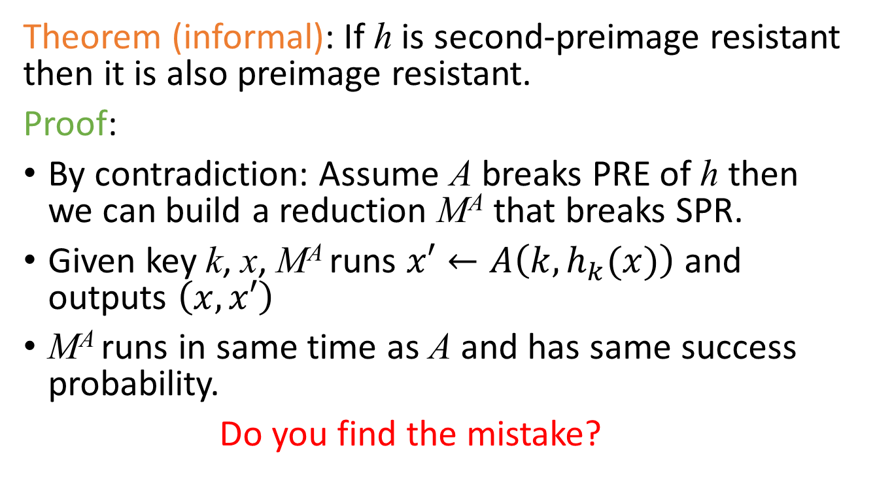
SPR -> PRE ?
Theorem (informal): If h is second-preimage resistant then it is also preimage resistant.
Proof:
By contradiction: Assume A breaks PRE of h then we can build a reduction M^{A} that breaks SPR.
Given key k, x, M^{A} runs $x′←A\left(k,h_{k}(x)\right)$ and outputs $\left(x,x′\right)$
M^{A} runs in same time as A and has same success probability.
Do you find the mistake?

Slide 14
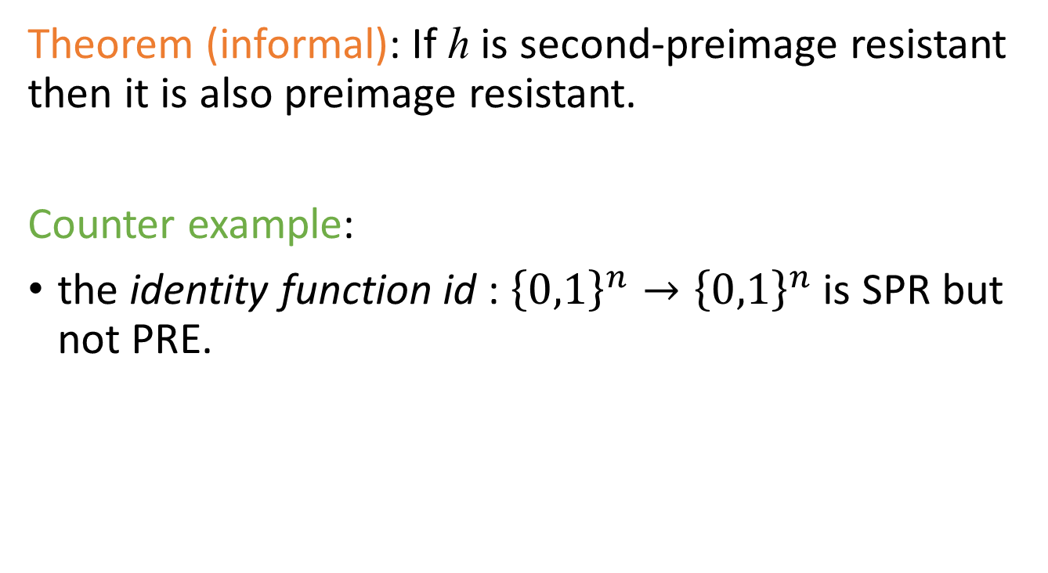
SPR -> PRE ?
Theorem (informal): If h is second-preimage resistant then it is also preimage resistant.
Counter example:
the identity function id : ${\left\{0,1\right\}}^{n}→{\left\{0,1\right\}}^{n}$ is SPR but not PRE.

Slide 15

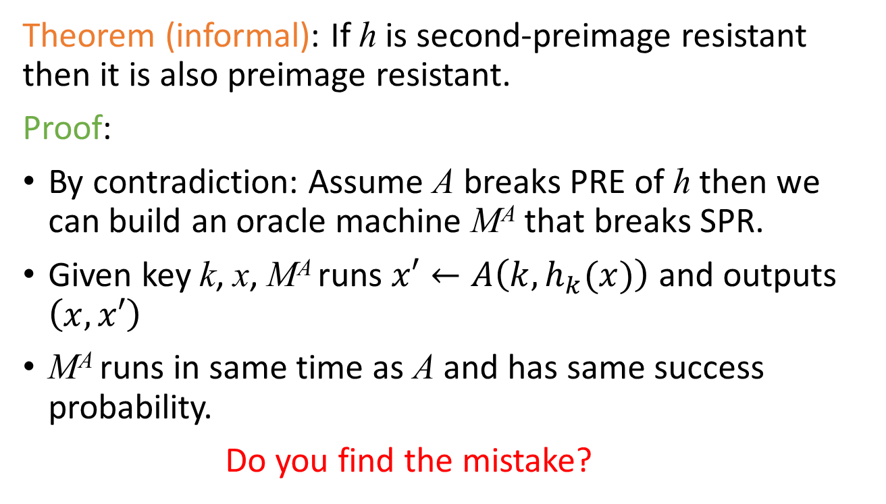
SPR -> PRE ?
Theorem (informal): If h is second-preimage resistant then it is also preimage resistant.
Proof:
By contradiction: Assume A breaks PRE of h then we can build an oracle machine M^{A} that breaks SPR.
Given key k, x, M^{A} runs $x′←A\left(k,h_{k}(x)\right)$ and outputs $\left(x,x′\right)$
M^{A} runs in same time as A and has same success probability.
Do you find the mistake?
We are not guaranteed that $x≠x^{′}$ !

Slide 16

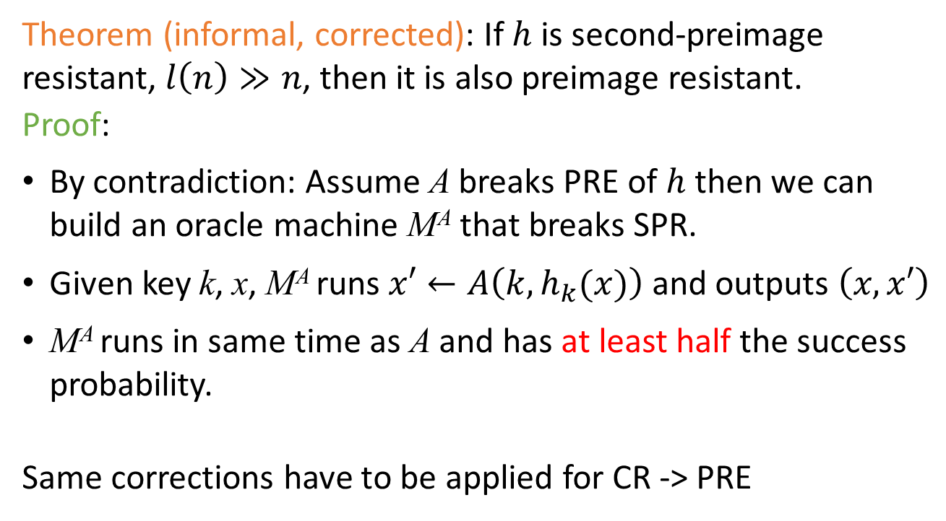
SPR -> PRE ?
Theorem (informal, corrected): If $h$ is second-preimage resistant, $l\left(n\right)≫n$, then it is also preimage resistant.
Proof:
By contradiction: Assume A breaks PRE of $h$ then we can build an oracle machine M^{A} that breaks SPR.
Given key k, x, M^{A} runs $x′←A\left(k,h_{k}(x)\right)$ and outputs $\left(x,x′\right)$
M^{A} runs in same time as A and has at least half the success probability.
Same corrections have to be applied for CR -> PRE
Can replace condition $l\left(n\right)≫n$ by requiring that h is “decisional second preimage resistant”.

Slide 17
Summary: Relations
Stronger assumption / easier to break
Collision-Resistance
Assumption / Attacks
2nd-Preimage-Resistance
weaker assumption/
harder to break
One-way

Slide 18
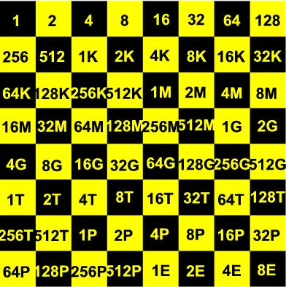
generic (brute force) attacks
assume: hash function behaves like random function
preimages and second preimages can be found by random guessing
search space: ≈ n bits, ≈ 2^{n} hash function calls
collisions can be found by birthdaying
  search space: ≈ ½n bits,
  ≈ 2^{½n} hash function calls
this is a big difference
  MD5 is a 128 bit hash function
  (second) preimage random search: ≈ 2¹²⁸ ≈ 3x10³⁸ MD5 calls
  collision birthday search: only ≈ 2⁶⁴ ≈ 2x10¹⁹ MD5 calls

Slide 19
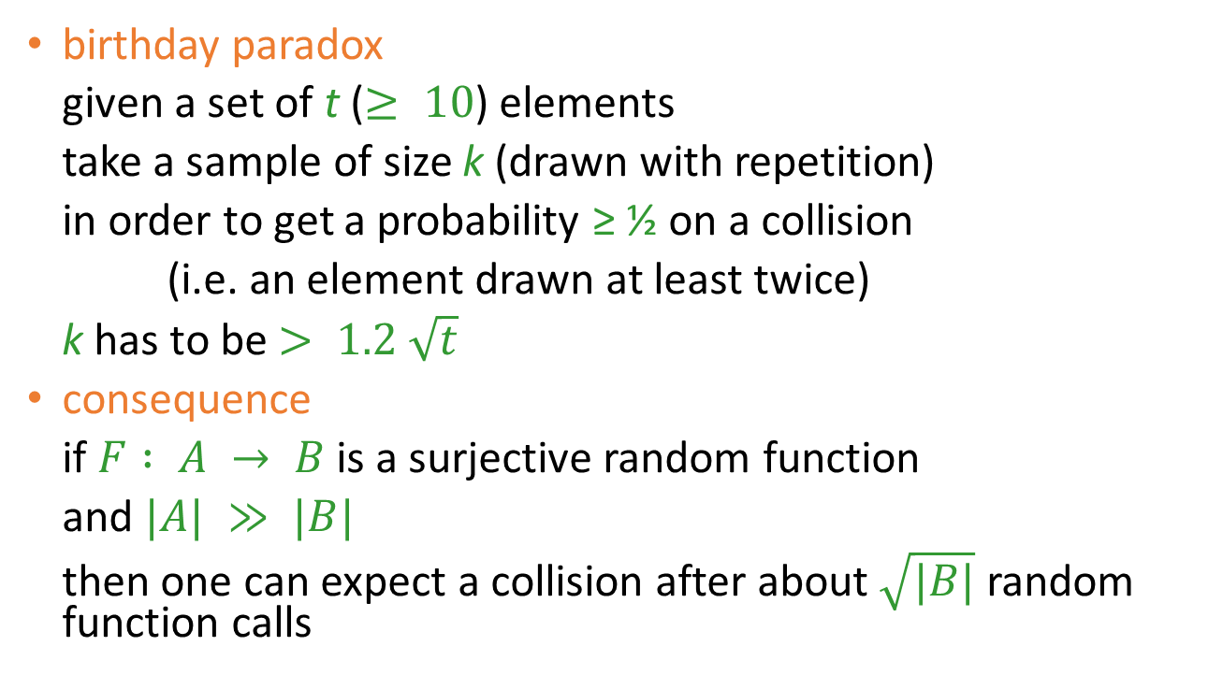
birthday paradox
birthday paradox
given a set of t ($≥ 10$) elements
take a sample of size k (drawn with repetition)
in order to get a probability ≥ ½ on a collision
(i.e. an element drawn at least twice)
k has to be $> 1.2 \sqrt{t}$
consequence
if $F : A → B$is a surjective random function
and $|A| ≫ |B|$
then one can expect a collision after about $\sqrt{|B|}$ random function calls

Slide 20
meaningful birthdaying
random birthdaying
  do exhaustive search on n/2 bits
  messages will be ‘random’
  messages will not be ‘meaningful’
Yuval (1979)
  start with two meaningful messages m₁, m₂ for which you want to find a collision
  identify n/2 independent positions where the messages can be changed at bit level without changing the meaning
    e.g. tab ←→ space, space ←→ newline, etc.
  do random search on those positions

Slide 21
implementing birthdaying
naïve
  store 2^{n/2} possible messages for m₁ and 2^{n/2} possible messages for m₂ and check all 2^{n} pairs
less naïve
  store 2^{n/2} possible messages for m₁ and for each possible m₂ check whether its hash is in the list
smart: Pollard-ρ with Floyd’s cycle finding algorithm
  computational complexity still O(2^{n/2})
  but only constant small storage required

Slide 22
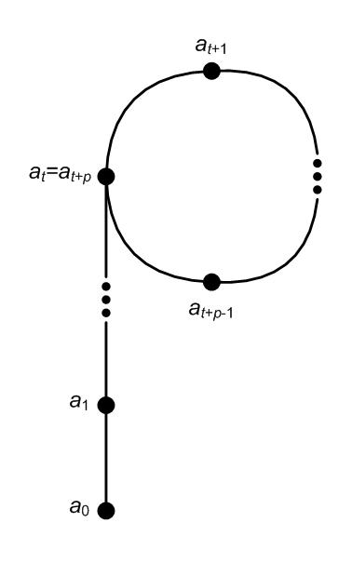
Pollard-ρ and Floyd cycle finding
Pollard-ρ
  iterate the hash function:
  a₀, a₁ = h(a₀), a₂ = h(a₁), a₃ = h(a₂), …
  this is ultimately periodic:
    there are minimal t, p such that
    a_{t+p} = a_{t}
    theory of random functions:
    both t, p are of size 2^{n/2}
Floyd’s cycle finding algorithm
  Floyd: start with (a₁,a₂) and compute
  (a₂,a₄), (a₃,a₆), (a₄,a₈), …, (a_{q},a_{2q})
  until a_{2q} = a_{q};
  this happens for some q < t + p

