Slide 1
Cryptographic Hash Functions
Part II
Cryptography 1
Andreas Hülsing, TU/e
Some slides by Sebastiaan de Hoogh, TU/e

Slide 2
Hash function design
Create fixed input size building block
Use building block to build compression function
Use „mode“ for length extension
Permutation / Block cipher
Compression function
Hash function
Engineering
Generic transforms
Cryptanalysis /
best practices
Reductionist proofs

Slide 3
(Length-Extension) Modes

Slide 4
Merkle-Damgård construction
Given:
compression function: CF : {0,1}^{n} x {0,1}^{r} → {0,1}^{n}
Goal:
Hash function: H : {0,1}* → {0,1}^{n}

Slide 5
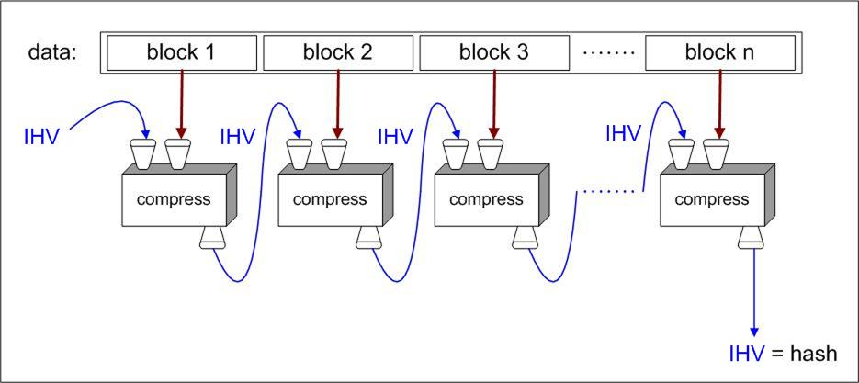
Merkle-Damgård - iterated compression

Slide 6
Merkle-Damgård construction
assume that message m can be split up into blocks m₁, …, m_{s} of equal block length r
  most popular block length is r = 512
compression function: CF : {0,1}^{n} x {0,1}^{r} → {0,1}^{n}
intermediate hash values (length n) as CF input and output
message blocks as second input of CF
start with fixed initial IHV₀ (a.k.a. IV = initialization vector)
iterate CF : IHV₁ = CF(IHV₀,m₁), IHV₂ = CF(IHV₁,m₂), …, IHV_{s} = CF(IHV_{s-1},m_{s}),
take h(m) = IHV_{s} as hash value
advantages:
  this design makes streaming possible
  hash function analysis becomes compression function analysis
  analysis easier because domain of CF is finite

Slide 7
padding
padding: add dummy bits to satisfy block length requirement
non-ambiguous padding: add one 1-bit and as many 0-bits as necessary to fill the final block
  when original message length is a multiple of the block length, apply padding anyway, adding an extra dummy block
  any other non-ambiguous padding will work as well

Slide 8
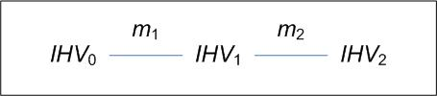
Merkle-Damgård strengthening
let padding leave final 64 bits open
encode in those 64 bits the original message length
  that’s why messages of length ≥ 2⁶⁴ are not supported
reasons:
  needed in the proof of the Merkle-Damgård theorem
  prevents some attacks such as
    trivial collisions for random IV
      now h(IHV₀,m₁||m₂) = h(IHV₁,m₂)
    see next slide for more

Slide 9
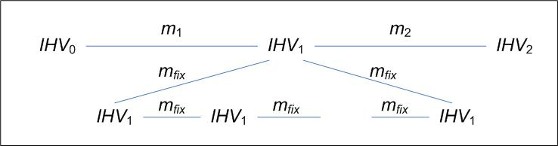
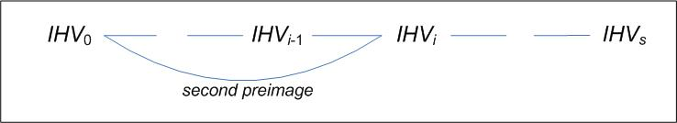
Merkle-Damgård strengthening, cont’d
    fixpoint attack
    fixpoint: IHV, m such that CF(IHV,m) = IHV
    long message attack
Notes:
Allows to find 2nd preimage in birthday time...

Slide 10
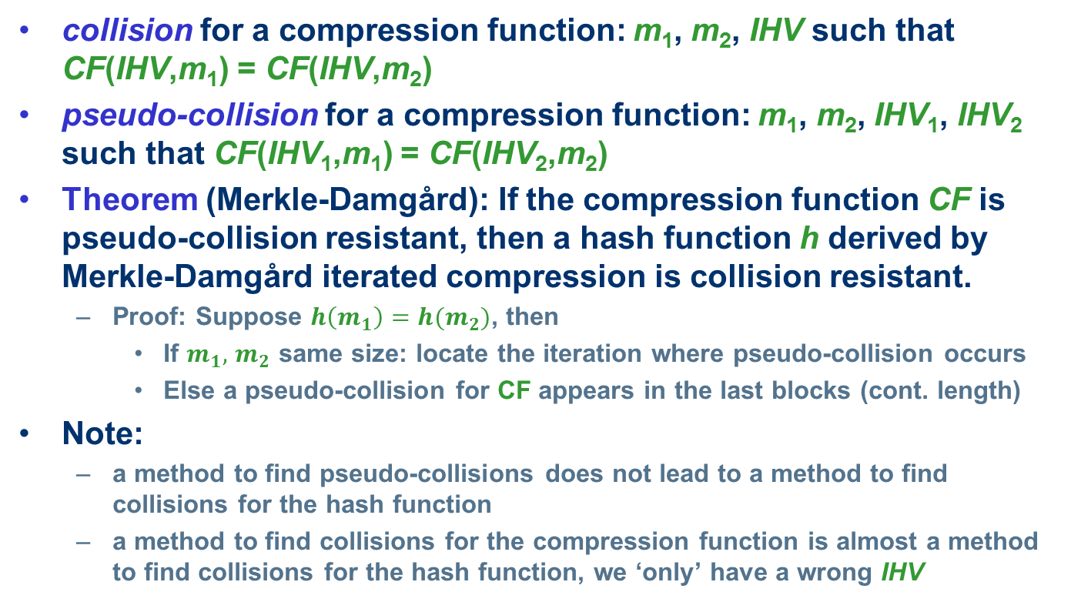
compression function collisions
collision for a compression function: m₁, m₂, IHV such that CF(IHV,m₁) = CF(IHV,m₂)
pseudo-collision for a compression function: m₁, m₂, IHV₁, IHV₂ such that CF(IHV₁,m₁) = CF(IHV₂,m₂)
Theorem (Merkle-Damgård): If the compression function CF is pseudo-collision resistant, then a hash function h derived by Merkle-Damgård iterated compression is collision resistant.
  Proof: Suppose $h\left(m_{1}\right)=h(m_{2})$, then
    If $m_{1},$ $m_{2}$ same size: locate the iteration where pseudo-collision occurs
    Else a pseudo-collision for CF appears in the last blocks (cont. length)
Note:
  a method to find pseudo-collisions does not lead to a method to find collisions for the hash function
  a method to find collisions for the compression function is almost a method to find collisions for the hash function, we ‘only’ have a wrong IHV

Slide 11
Sponges
Given:
permutation: f : {0,1}^{b} → {0,1}^{b}
Goal:
Hash function: H : {0,1}* → {0,1}^{n}
( actually H : {0,1}* → {0,1}* )
(Already includes CF design, more later)

Slide 12
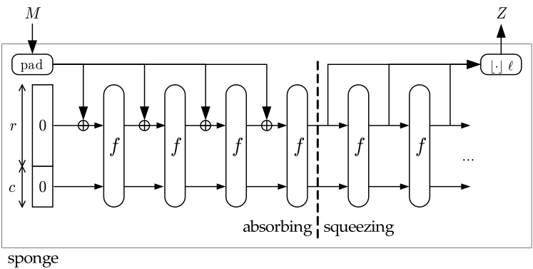
Sponges
Used and introduced in SHA3 aka Keccak
  Guido Bertoni, Joan Daemen, Michaël Peeters and Gilles Van Assche

Slide 13
Intercourse: Random oracles
Models the perfect hash function
Truely random function without any structure
Best attacks: Generic attacks (No structure available!)
Issue:
No way to build a RO with polynomial description
Mind Model:
Lazy-sampling
  Imagine a black box implementing the function
  For every new query, a random response is sampled
  For old queries, former response is used

Slide 14
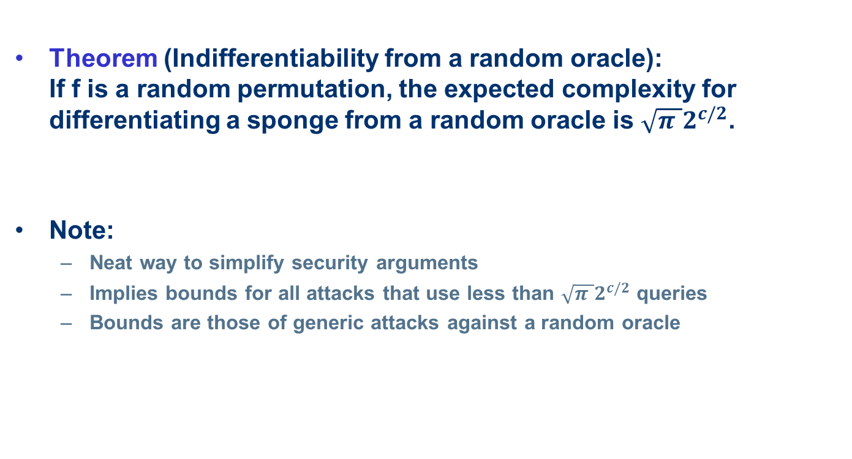
Sponge security
Theorem (Indifferentiability from a random oracle):
If f is a random permutation, the expected complexity for differentiating a sponge from a random oracle is $\sqrt{π }2^{c/2}$.
Note:
  Neat way to simplify security arguments
  Implies bounds for all attacks that use less than $\sqrt{π }2^{c/2}$ queries
  Bounds are those of generic attacks against a random oracle

Slide 15
Sponges
Used and introduced in SHA3 aka Keccak
  Guido Bertoni, Joan Daemen, Michaël Peeters and Gilles Van Assche

Slide 16
Compression Function Design

Slide 17
Block-Cipher-based designs
Traditional approach
Many possible modes
  see Preneel, Govaerts, Vandewalle. Hash functions based on block ciphers: a synthetic approach. CRYPTO’93
  security: Black, Rogaway, Shrimpton. Black-Box Analysis of the Block-Cipher-Based Hash-Function Constructions from PGV. CRYPTO’02
Most popular: Matyas-Meyer-Oseas
M_{i}
IHV_{i}
IHV_{i+1}

Slide 18
Permutation-based designs
Less frequent use
Keccak compression function:
Important: NEVER hand out last c bits of IHV!
M_{i}
r
IHV_{i}
IHV_{i+1}
c

Slide 19
Security
Generally analyzed in idealized models:
  „Black-box models“
  Ideal cipher model
  Random oracle model
  Random permutation model
Proofs assuming underlying building block behaves like such an idealized building block

Slide 20
Basic Building Blocks

Slide 21
the MD4 family of hash functions
MD4
(Rivest 1990)
RIPEMD
(RIPE 1992)
SHA-0
(NIST 1993)
MD5
(Rivest 1992)
HAVAL
(Zheng, Pieprzyk, Seberry 1993)
SHA-1
(NIST 1995)
RIPEMD-128 RIPEMD-160 RIPEMD-256 RIPEMD-320
(Dobbertin, Bosselaers, Preneel 1992)
SHA-224 SHA-256 SHA-384 SHA-512
(NIST 2004)

Slide 22
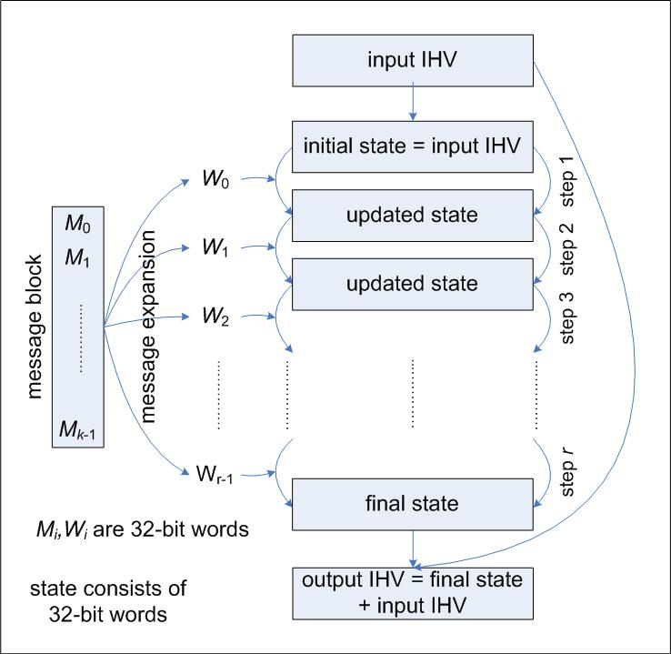
design of MD4 family compression functions
message block
split into words
message expansion
input words for each step
IHV → initial state
each step updates state with an input word
final state ‘added’ to IHV
  (feed-forward)

Slide 23
design details
MD4, MD5, SHA-0, SHA-1 details:
  512-bit message block split into 16 32-bit words
  state consists of 4 (MD4, MD5) or 5 (SHA-0, SHA-1) 32-bit words
  MD4: 3 rounds of 16 steps each, so 48 steps, 48 input words
  MD5: 4 rounds of 16 steps each, so 64 steps, 64 input words
  SHA-0, SHA-1: 4 rounds of 20 steps each, so 80 steps, 80 input words
  message expansion and step operations use only very easy to implement operations:
    bitwise Boolean operations
    bit shifts and bit rotations
    addition modulo 2³²
  proper mixing believed to be cryptographically strong

Slide 24
message expansion
MD4, MD5 use roundwise permutation, for MD5:
  W₀ = M₀, W₁ = M₁, …, W₁₅ = M₁₅,
  W₁₆ = M₁, W₁₇ = M₆, …, W₃₁ = M₁₂, (jump 5 mod 16)
  W₃₂ = M₅, W₃₃ = M₈, …, W₄₇ = M₂, (jump 3 mod 16)
  W₄₈ = M₀, W₄₉ = M₇, …, W₆₃ = M₉ (jump 7 mod 16)
SHA-0, SHA-1 use recursivity
  W₀ = M₀, W₁ = M₁, …, W₁₅ = M₁₅,
  SHA-0: W_{i} = W_{i-3} XOR W_{i-8} XOR W_{i-14} XOR W_{i-16} for i = 16, …, 79
  problem: k^{th} bit influenced only by k^{th} bits of preceding words, so not much diffusion
  SHA-1: W_{i} = (W_{i-3} XOR W_{i-8} XOR W_{i-14} XOR W_{i-16} )<<<1
  (additional rotation by 1 bit,
  this is the only difference between SHA-0 and SHA-1)

Slide 25
Example: step operations in MD5
in each step only one state word is updated
the other state words are rotated by 1
state update:
A’ = B + ((A + f_{i}(B,C,D) + W_{i} + K_{i}) <<< s_{i} )
K_{i}, s_{i} step dependent constants,
+ is addition mod 2³²,
f_{i} round dependend boolean functions:
f_{i}(x,y,z) = xy OR (¬x)z for i = 1, …, 16,
f_{i}(x,y,z) = xz OR y(¬z) for i = 17, …, 32, f_{i}(x,y,z) = x XOR y XOR z for i = 33, …, 48,
f_{i}(x,y,z) = y XOR (y OR (¬z)) for i = 49, …, 64,
these functions are nonlinear, balanced, and
have an avalanche effect

Slide 26
step operations in MD5

Slide 27
provable hash functions
people don’t like that one can’t prove much about hash functions
reduction to established ‘hard problem’ such as factoring is seen as an advantage
Example: VSH – Very Smooth Hash
  Contini-Lenstra-Steinfeld 2006
  collision resistance provable under assumption that a problem directly related to factoring is hard
  but still far from ideal
    bad performance compared to SHA-256
    all kinds of multiplicative relations between hash values exist
    not post-quantum secure

Slide 28
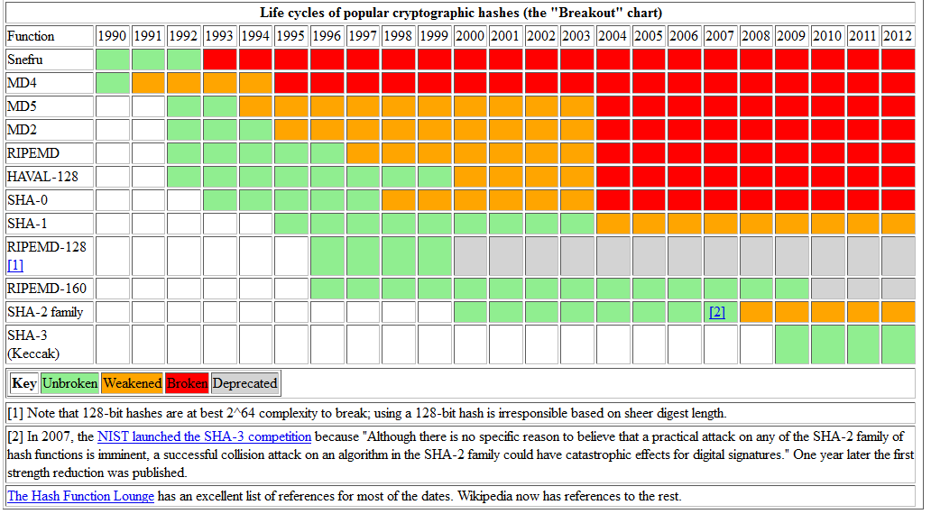

Slide 29
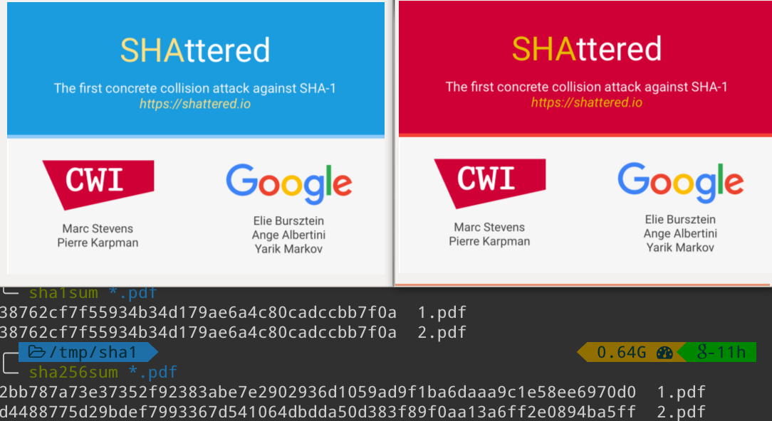

Slide 30
Real life attacks on MD5

Slide 31
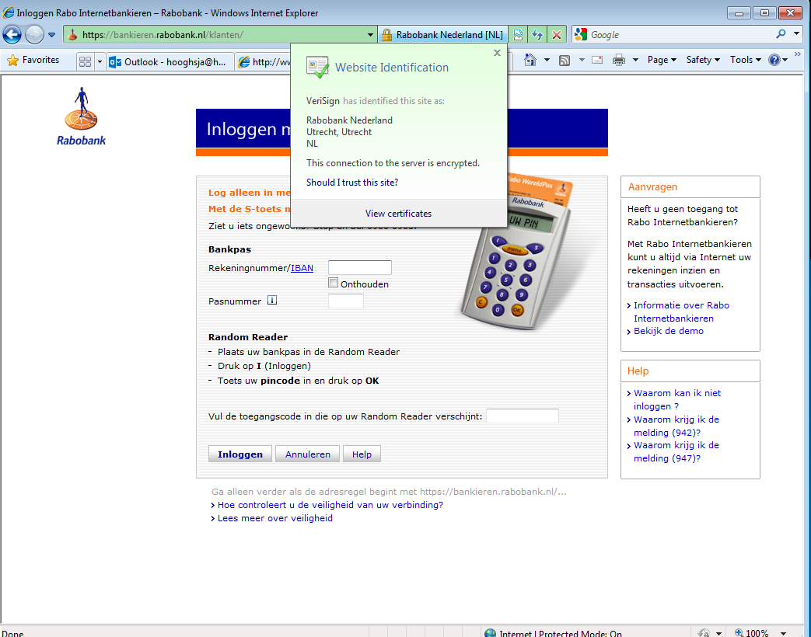
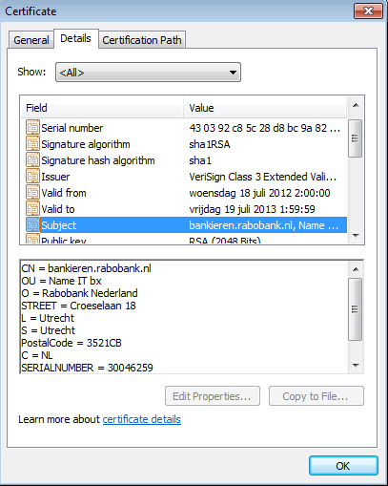
Example Hash-then-Sign in Browser

Slide 32
Wang’s attack on MD5
two-block collision
  for any input IHV, identical for the two messages
  i.e. IHV₀ = IHV₀’, ΔIHV₀ = 0
  near-collision after first block:
  IHV₁ = CF(IHV₀,m₁), IHV₁’ = CF(IHV₀,m₁’),
  with ΔIHV₁ having only a few carefully chosen ±1s
  full collision after second block:
  IHV₂ = CF(IHV₁,m₂), = CF(IHV₁’,m₂’),
  i.e. IHV₂ = IHV₂’, ΔIHV₂ = 0
with IHV₀ the standard IV for MD5, and a third block for padding and MD-strengthening, this gives a collision for the full MD5

Slide 33
chosen-prefix collisions
latest development on MD5
Marc Stevens (TU/e MSc student) 2006
  paper by Marc Stevens, Arjen Lenstra and Benne de Weger, EuroCrypt 2007
Marc Stevens (CWI PhD student) 2009
  paper by Marc Stevens, Alex Sotirov, Jacob Appelbaum, David Molnar, Dag Arne Osvik, Arjen Lenstra and Benne de Weger, Crypto 2007
  rogue CA attack

Slide 34
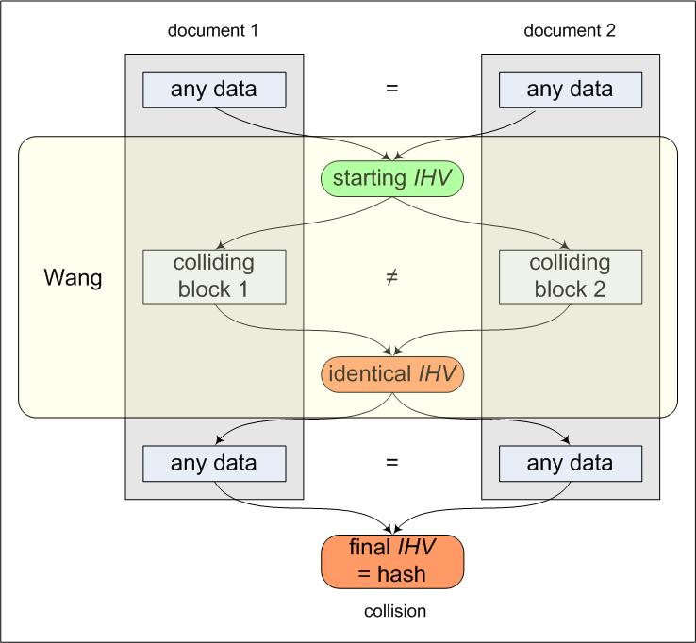
MD5: identical IV attacks
all attacks following Wang’s method, up to recently
MD5 collision attacks work for any starting IHV
  data before and after the collision can be chosen at will
but starting IHVs must be identical
  data before and after the collision must be identical
called random collision

Slide 35
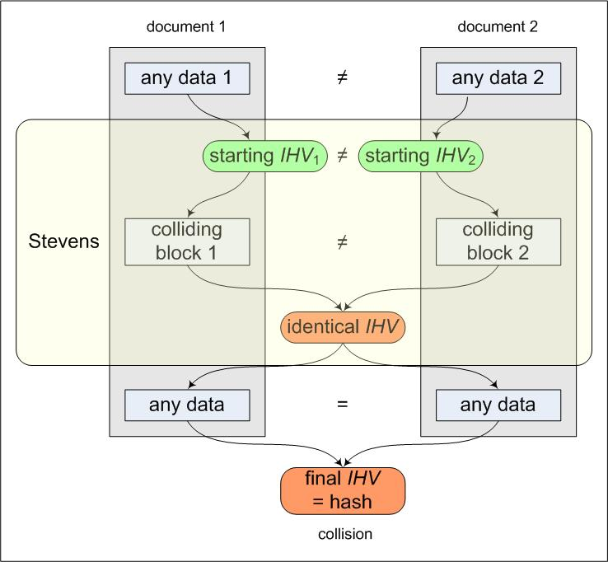
MD5: different IV attacks
new attack
  Marc Stevens, TU/e
  Oct. 2006
MD5 collisions for any starting pair {IHV₁, IHV₂}
  data before the collision needs not to be identical
  data before the collision can still be chosen at will, for each of the two documents
  data after the collision still must be identical
called chosen-prefix collision

Slide 36
indeed that was not the end in 2008 the ethical hackers came by
observation: commercial certification authorities still use MD5
idea: proof of concept of realistic attack as wake up call
attack a real, commercial certification authority
purchase a web certificate for a valid web domain
but with a “little tweak” built in
prepare a rogue CA certificate with identical MD5 hash
the commercial CA’s signature also holds for the rogue CA certificate

Slide 37
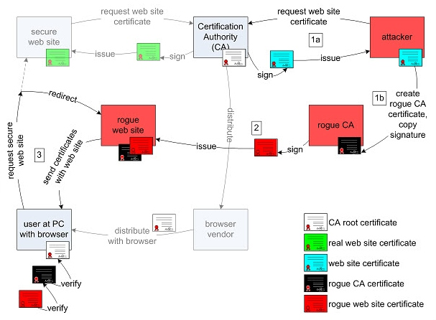
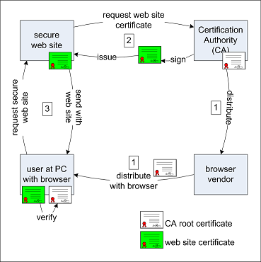
Outline of the RogueCA Attack

Slide 38
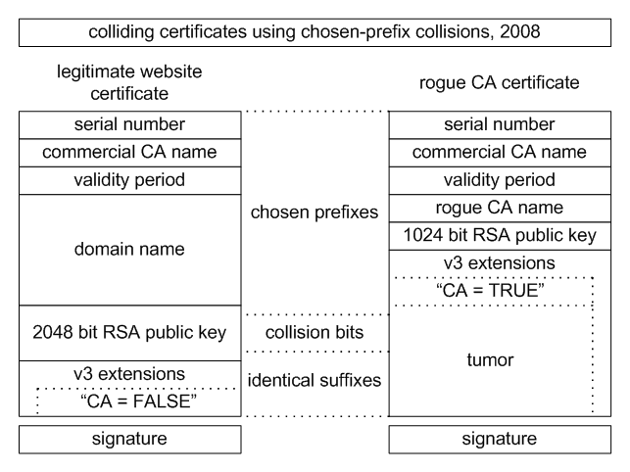
Subject = CA
Subject = End Entity

Slide 39
problems to be solved
predict the serial number
predict the time interval of validity
at the same time
a few days before
more complicated certificate structure
“Subject Type” after the public key
small space for the collision blocks
is possible but much more computations needed
not much time to do computations
to keep probability of prediction success reasonable

Slide 40
how difficult is predicting?
time interval:
CA uses automated certification procedure
certificate issued exactly 6 seconds after click
serial number :
  Nov 3 07:44:08 2008 GMT 643006
  Nov 3 07:45:02 2008 GMT 643007
  Nov 3 07:46:02 2008 GMT 643008
  Nov 3 07:47:03 2008 GMT 643009
  Nov 3 07:48:02 2008 GMT 643010
  Nov 3 07:49:02 2008 GMT 643011
  Nov 3 07:50:02 2008 GMT 643012
  Nov 3 07:51:12 2008 GMT 643013
  Nov 3 07:51:29 2008 GMT 643014
  Nov 3 07:52:02 2008 GMT have a guess…

Slide 41
the attack at work
estimated: 800-1000 certificates issued in a weekend
procedure:
  buy certificate on Friday, serial number S-1000
  predict serial number S for time T Sunday evening
  make collision for serial number S and time T: 2 days time
  short before T buy additional certificates until S-1
  buy certificate on time T-6
  hope that nobody comes in between and steals our serial number S

Slide 42
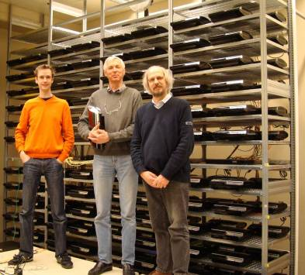
to let it work
cluster of >200
PlayStation3
game consoles
(1 PS3 = 40 PC’s)
complexity: 2⁵⁰
memory: 30 GB
→ collision in 1 day

Slide 43
result
success after 4th attempt (4th weekend)
purchased a few hundred certificates
(promotion action: 20 for one price)
total cost: < US$ 1000

Slide 44
conclusion on MD5
at this moment, ‘meaningful’ hash collisions are
  easy to make
  but also easy to detect
  still hard to abuse realistically
with chosen-prefix collisions we come close to realistic attacks
to do real harm, second pre-image attack needed
  real harm is e.g. forging digital signatures
  this is not possible yet, not even with MD5
More information: http://www.win.tue.nl/hashclash/

Slide 45
Questions?

Slide 46
proof of birthday paradox
probability that all k elements are distinct is
and this is < ½ when k(k-1) > (2 log 2)t
(≈ k²) (≈ 1.4 t)

