Slide 1
Cryptographic Hash Functions
Part I
Cryptography 1
Andreas Hülsing, TU/e
Based on slides by Sebastiaan de Hoogh, TU/e

Slide 2
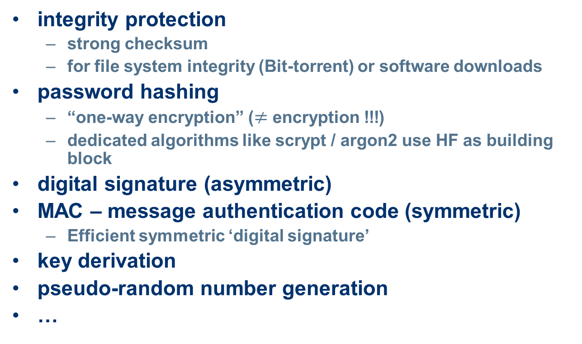
how are hash functions used?
integrity protection
  strong checksum
  for file system integrity (Bit-torrent) or software downloads
password hashing
  “one-way encryption” ($≠$ encryption !!!)
  dedicated algorithms like scrypt / argon2 use HF as building block
digital signature (asymmetric)
MAC – message authentication code (symmetric)
  Efficient symmetric ‘digital signature’
key derivation
pseudo-random number generation
…

Slide 3

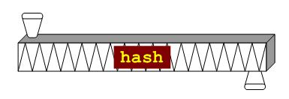
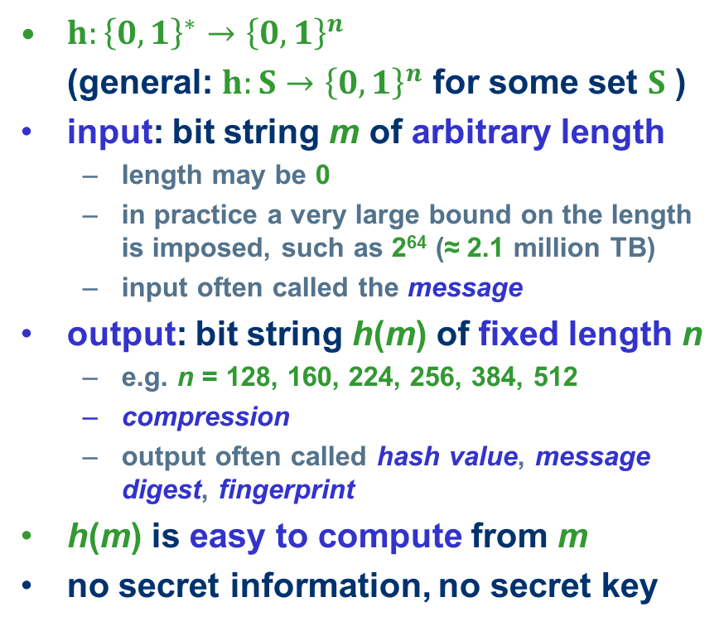
what is a hash function?
$h:{\left\{0,1\right\}}^{∗}→{\left\{0,1\right\}}^{n}$
(general: $h:S→{\left\{0,1\right\}}^{n}$ for some set $S$ )
input: bit string m of arbitrary length
  length may be 0
  in practice a very large bound on the length is imposed, such as 2⁶⁴ (≈ 2.1 million TB)
  input often called the message
output: bit string h(m) of fixed length n
  e.g. n = 128, 160, 224, 256, 384, 512
  compression
  output often called hash value, message digest, fingerprint
h(m) is easy to compute from m
no secret information, no secret key

Slide 4

hash collision
m₁, m₂ are a collision for h if
h(m₁) = h(m₂) while m₁ ≠ m₂
I owe you € 100
I owe you € 5000
different
documents
there exist a lot of collisions
  pigeonhole principle
  (a.k.a. Schubladensatz)
identical hash
=
collision

Slide 5
preimage
given h₀, then m is a preimage of h₀ if
h(m) = h₀
Note:
h₀ might have many preimages!
X

Slide 6

second preimage
given m₀, then m is a second preimage of m₀ if
h(m) = h(m₀ ) while m ≠ m₀
?
X

Slide 7
cryptographic hash function requirements
collision resistance: it should be computationally infeasible to find a collision m₁, m₂ for h
  i.e. h(m₁) = h(m₂)
preimage resistance: given h₀ it should be computationally infeasible to find a preimage m for h₀ under h
  i.e. h(m) = h₀
second preimage resistance: given m₀ it should be computationally infeasible to find a colliding m for m₀ under h
  i.e. h(m) = h(m₀)

Slide 8
Other terminology (don’t use)
one-way function = preimage resistant
weak collision resistant = second preimage resistant
strong collison resistant = collision resistant
OWHF – one-way hash function
  preimage resistant
CRHF – collision resistant hash function
  second preimage resistant and collision resistant
Don‘t use these. Be more specific!

Slide 9
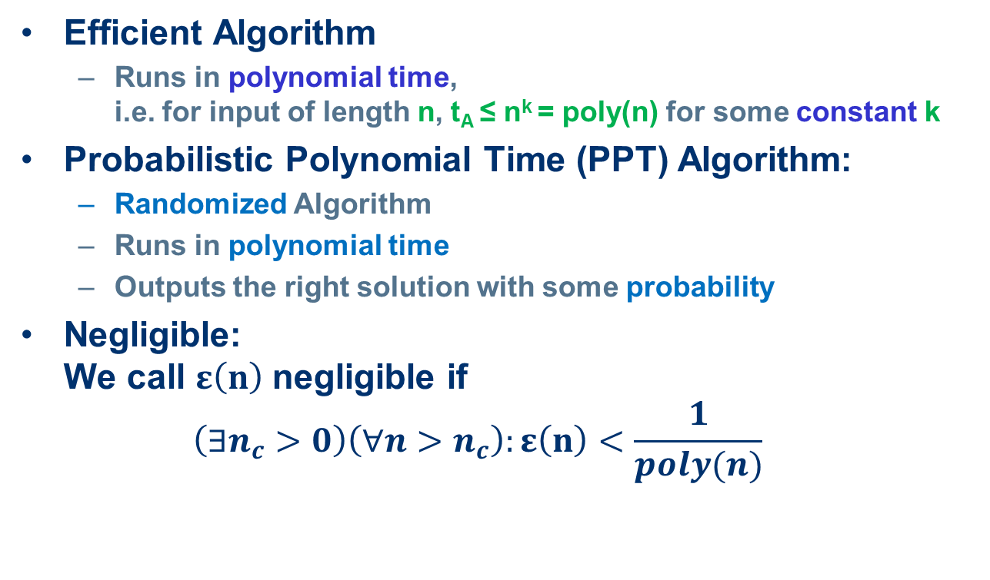
Formal treatment
Efficient Algorithm
  Runs in polynomial time,
  i.e. for input of length n, t_{A} ≤ n^{k} = poly(n) for some constant k
Probabilistic Polynomial Time (PPT) Algorithm:
  Randomized Algorithm
  Runs in polynomial time
  Outputs the right solution with some probability
Negligible:
We call $ε\left(n\right)$negligible if
$\left(∃n_{c}>0\right)\left(∀n>n_{c}\right):ε\left(n\right)<\frac{1}{poly(n)}$

Slide 10
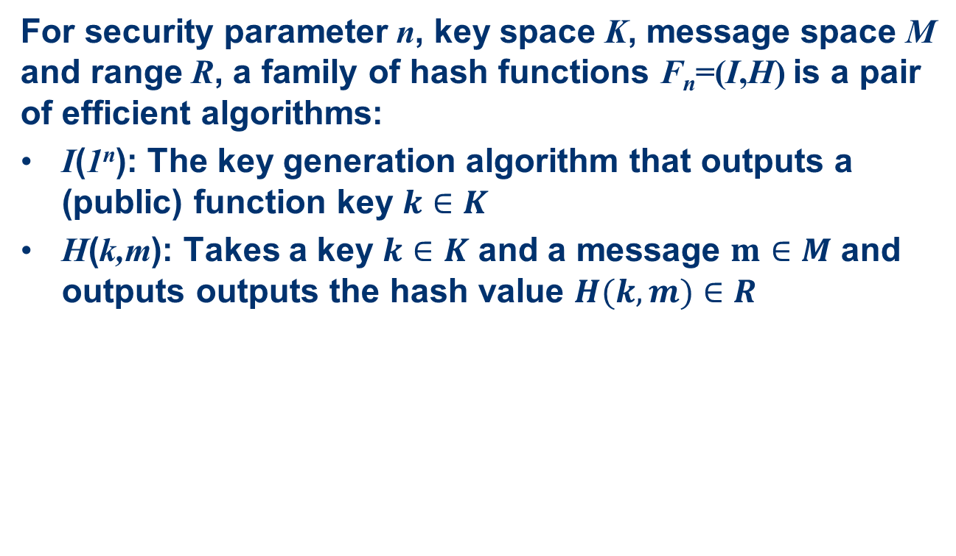
Formal treatment
For security parameter n, key space K, message space M and range R, a family of hash functions F_{n}=(I,H) is a pair of efficient algorithms:
I(1^{n}): The key generation algorithm that outputs a (public) function key $k∈K$
H(k,m): Takes a key $k∈K$ and a message $m∈M$ and outputs outputs the hash value $H(k,m)∈R$

Slide 11
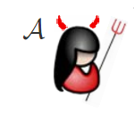

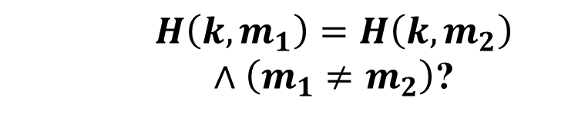


Formal security properties: CR
C
$$k←I\left(1^{n}\right)$$
$$k$$
$$\left(m_{1},m_{2}\right)$$
$$H\left(k,m_{1}\right)=H\left(k,m_{2}\right)$$
$∧\left(m_{1}≠m_{2}\right)$?

Slide 12
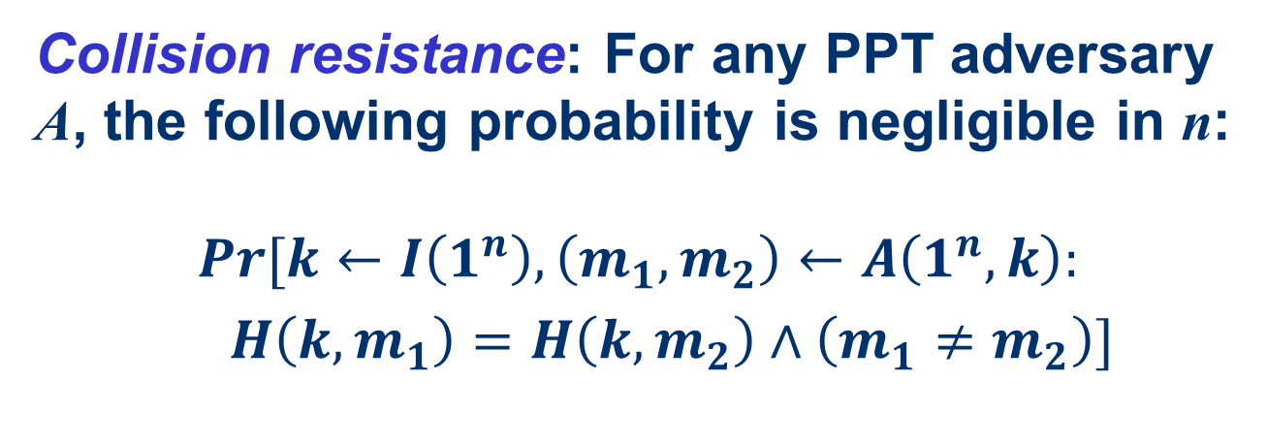
Formal security properties: CR
Collision resistance: For any PPT adversary A, the following probability is negligible in n:
$$Pr[k←I\left(1^{n}\right),\left(m_{1},m_{2}\right)←A\left(1^{n},k\right):$$
$H\left(k,m_{1}\right)=H\left(k,m_{2}\right)∧\left(m_{1}≠m_{2}\right)]$

Slide 13
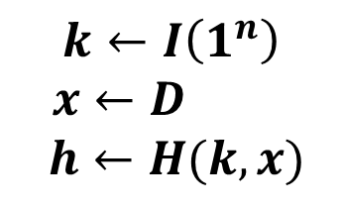



Formal security properties: PRE
C
$$k←I\left(1^{n}\right)$$
$x←D$
$$h←H(k,x)$$
$$k,h$$
$$m$$
$H\left(k,m\right)=h$?

Slide 14
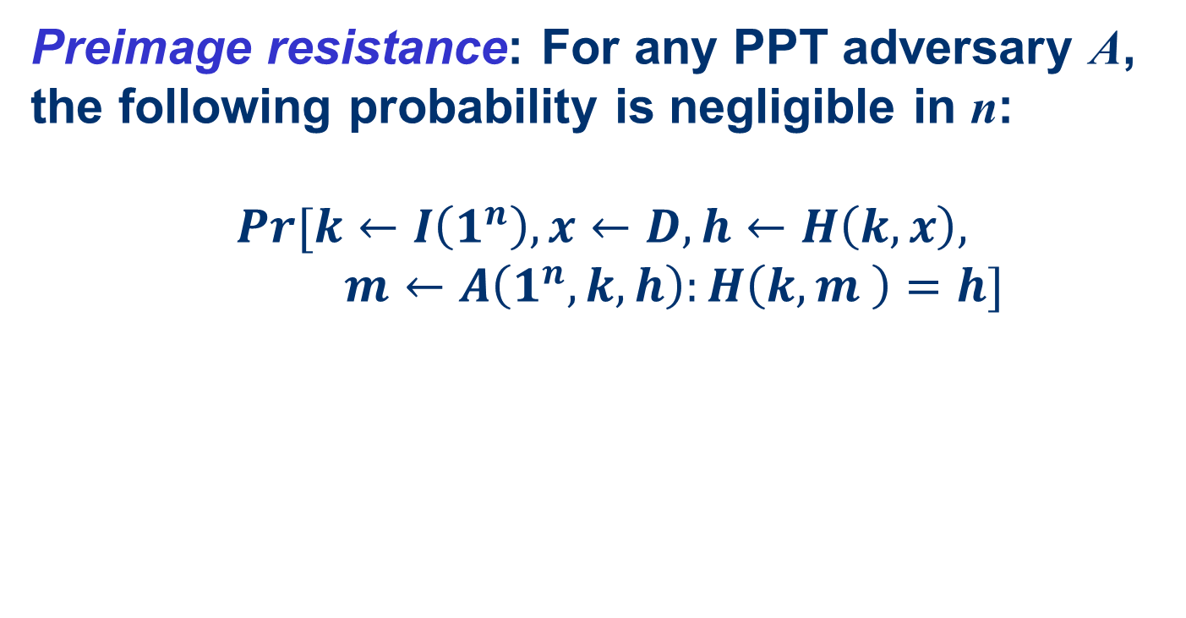
Formal security properties: PRE
Preimage resistance: For any PPT adversary A, the following probability is negligible in n:
$$Pr[k←I\left(1^{n}\right),x←D,h←H\left(k,x\right),$$
$m←A\left(1^{n},k,h\right):H\left(k,m \right)=h]$

Slide 15
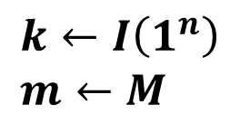
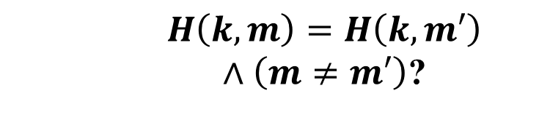


Formal security properties: SPR
C
$$k←I\left(1^{n}\right) \\ m←M$$
$$m,k$$
$$m′$$
$$H\left(k,m\right)=H\left(k,m′\right)$$
$∧\left(m≠m′\right)$?

Slide 16
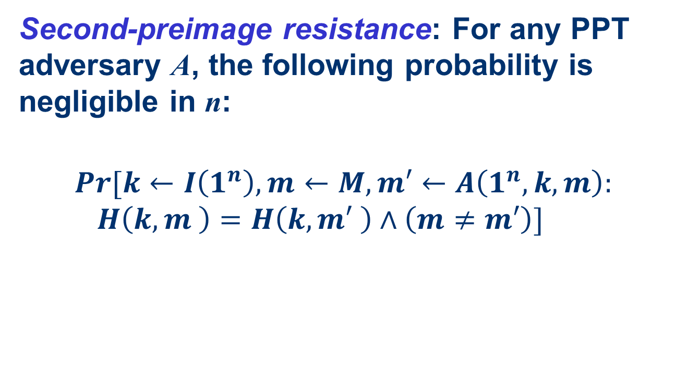
Formal security properties: SPR
Second-preimage resistance: For any PPT adversary A, the following probability is negligible in n:
$$Pr[k←I\left(1^{n}\right),m←M,m′←A\left(1^{n},k,m\right):$$
$H\left(k,m \right)=H\left(k,m′ \right)∧\left(m≠m′\right)]$

Slide 17
Reductions
Transform an algorithm for problem 1 into an algorithm for problem 2.
„Reduces problem 2 to problem 1“
Allows to relate the hardness of problems:
If there exists an efficient reduction that reduces problem 2 to problem 1 then an efficient algorithm solving problem 1 can be used to efficiently solve problem 2.

Slide 18
Reductions II
Use in cryptography:
Relate security properties
„Provable Security“: Reduce an assumed to be hard problem to breaking the security of your scheme.
Actually this does not proof security! Only shows that scheme is secure IF the problem is hard.

Slide 19
Relations between hash function security properties

Slide 20
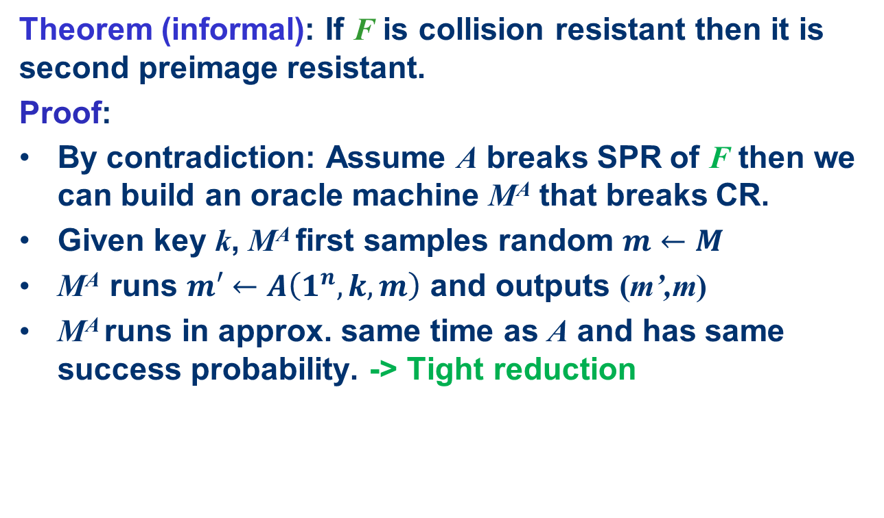
Easy start: CR -> SPR
Theorem (informal): If F is collision resistant then it is second preimage resistant.
Proof:
By contradiction: Assume A breaks SPR of F then we can build an oracle machine M^{A} that breaks CR.
Given key k, M^{A} first samples random $m←M$
M^{A} runs $m′←A\left(1^{n},k,m\right)$ and outputs (m’,m)
M^{A} runs in approx. same time as A and has same success probability. -> Tight reduction

Slide 21



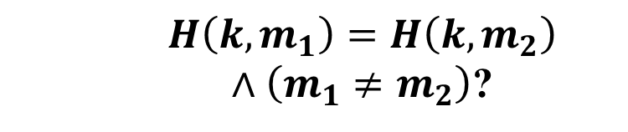



Reduction: CR -> SPR
C
M^{A}
$$k←I\left(1^{n}\right)$$
$$k$$
$$m_{1}←M$$
$$m_{1},k$$
$$m_{2}$$
$$\left(m_{1},m_{2}\right)$$
$$H\left(k,m_{1}\right)=H\left(k,m_{2}\right)$$
$∧\left(m_{1}≠m_{2}\right)$?

Slide 22
Easy start: CR -> SPR
Theorem (informal): If F is collision resistant then it is second preimage resistant.
Proof:
By contradiction: Assume A breaks SPR of F then we can build an oracle machine M^{A} that breaks CR.
Given key k, M^{A} first samples random $m←M$
M^{A} runs $m′←A\left(1^{n},k,m\right)$ and outputs (m’,m)
M^{A} runs in approx. same time as A and has same success probability. -> Tight reduction

Slide 23
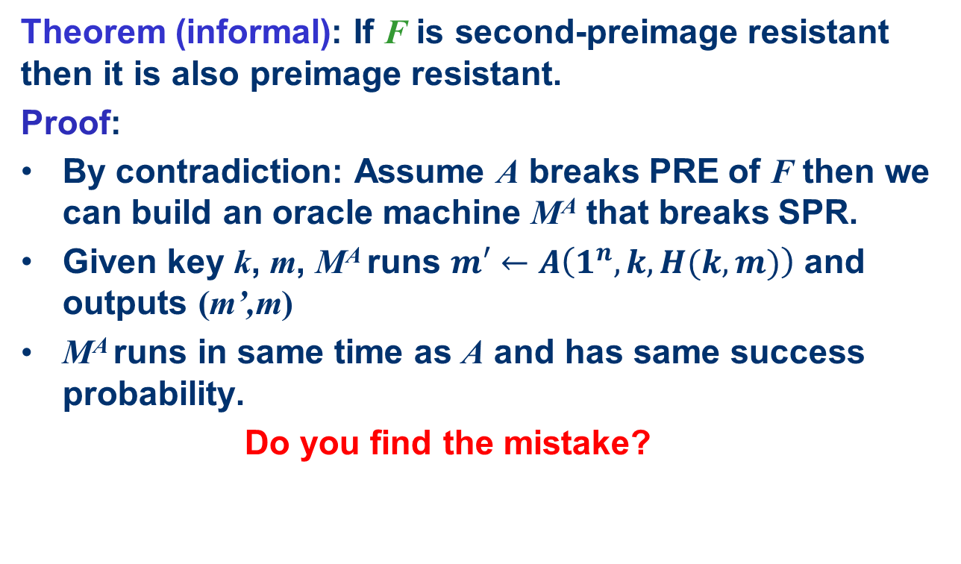
SPR -> PRE ?
Theorem (informal): If F is second-preimage resistant then it is also preimage resistant.
Proof:
By contradiction: Assume A breaks PRE of F then we can build an oracle machine M^{A} that breaks SPR.
Given key k, m, M^{A} runs $m′←A\left(1^{n},k,H(k,m)\right)$ and outputs (m’,m)
M^{A} runs in same time as A and has same success probability.
Do you find the mistake?

Slide 24
SPR -> PRE ?
Theorem (informal): If F is second-preimage resistant then it is also preimage resistant.
Counter example:
the identity function id : {0,1}^{n} → {0,1}^{n} is second-preimage resistant but not preimage resistant

Slide 25

SPR -> PRE ?
Theorem (informal): If F is second-preimage resistant then it is also preimage resistant.
Proof:
By contradiction: Assume A breaks PRE of F then we can build an oracle machine M^{A} that breaks SPR.
Given key k, m, M^{A} runs $m′←A\left(1^{n},k,H(k,m)\right)$ and outputs (m’,m)
M^{A} runs in same time as A and has same success probability.
Do you find the mistake?
We are not guaranteed that $m≠m^{′}$ !

Slide 26
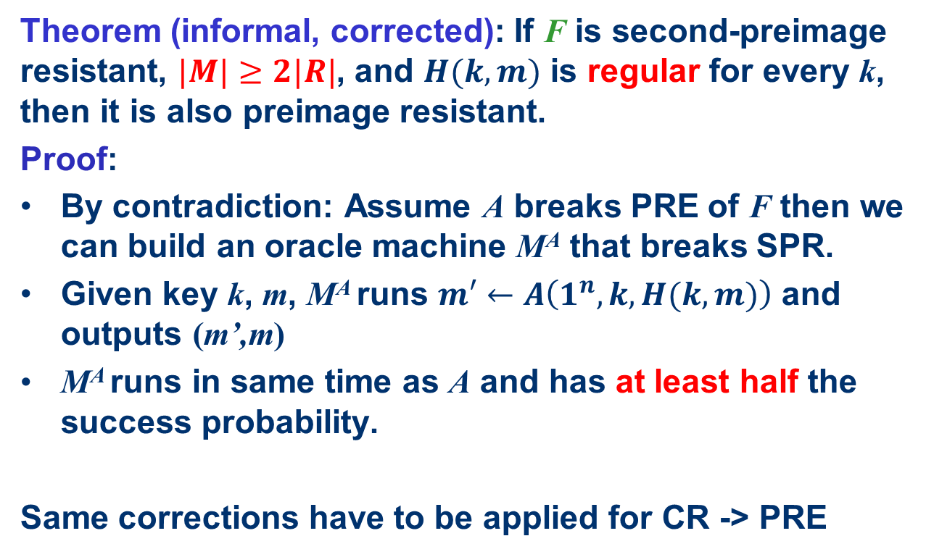
SPR -> PRE ?
Theorem (informal, corrected): If F is second-preimage resistant, $|M|≥2|R|$, and $H(k,m)$ is regular for every k, then it is also preimage resistant.
Proof:
By contradiction: Assume A breaks PRE of F then we can build an oracle machine M^{A} that breaks SPR.
Given key k, m, M^{A} runs $m′←A\left(1^{n},k,H(k,m)\right)$ and outputs (m’,m)
M^{A} runs in same time as A and has at least half the success probability.
Same corrections have to be applied for CR -> PRE

Slide 27
Summary: Relations
stronger / easier to break
Collision-Resistance
Assumption / Attacks
2nd-Preimage-Resistance
weaker /
harder to break
One-way

Slide 28
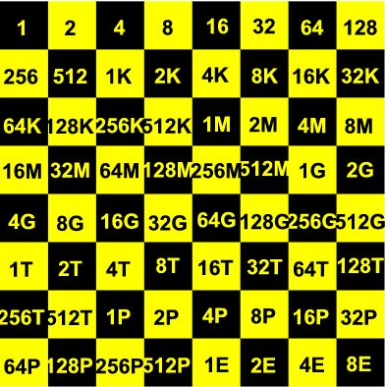
generic (brute force) attacks
assume: hash function behaves like random function
preimages and second preimages can be found by random guessing search
  search space: ≈ n bits, ≈ 2^{n} hash function calls
collisions can be found by birthdaying
  search space: ≈ ½n bits,
  ≈ 2^{½n} hash function calls
this is a big difference
  MD5 is a 128 bit hash function
  (second) preimage random search: ≈ 2¹²⁸ ≈ 3x10³⁸ MD5 calls
  collision birthday search: only ≈ 2⁶⁴ ≈ 2x10¹⁹ MD5 calls

Slide 29
birthday paradox
birthday paradox
given a set of t (≥ 10) elements
take a sample of size k (drawn with repetition)
in order to get a probability ≥ ½ on a collision
(i.e. an element drawn at least twice)
k has to be > 1.2 √t
consequence
if F : A → B is a surjective random function
and |A| >> |B|
then one can expect a collision after about √(|B|) random function calls

Slide 30
meaningful birthdaying
random birthdaying
  do exhaustive search on n/2 bits
  messages will be ‘random’
  messages will not be ‘meaningful’
Yuval (1979)
  start with two meaningful messages m₁, m₂ for which you want to find a collision
  identify n/2 independent positions where the messages can be changed at bitlevel without changing the meaning
    e.g. tab ←→ space, space ←→ newline, etc.
  do random search on those positions

Slide 31
implementing birthdaying
naïve
  store 2^{n/2} possible messages for m₁ and 2^{n/2} possible messages for m₂ and check all 2^{n} pairs
less naïve
  store 2^{n/2} possible messages for m₁ and for each possible m₂ check whether its hash is in the list
smart: Pollard-ρ with Floyd’s cycle finding algorithm
  computational complexity still O(2^{n/2})
  but only constant small storage required

Slide 32
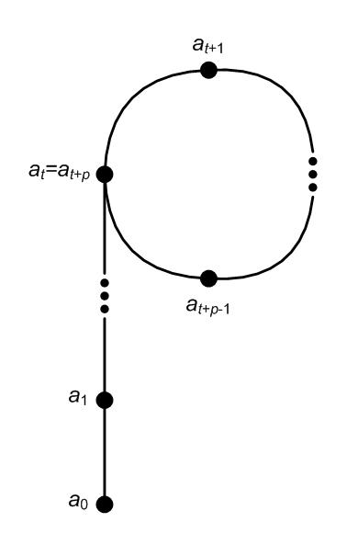
Pollard-ρ and Floyd cycle finding
Pollard-ρ
  iterate the hash function:
  a₀, a₁ = h(a₀), a₂ = h(a₁), a₃ = h(a₂), …
  this is ultimately periodic:
    there are minimal t, p such that
    a_{t+p} = a_{t}
    theory of random functions:
    both t, p are of size 2^{n/2}
Floyd’s cycle finding algorithm
  Floyd: start with (a₁,a₂) and compute
  (a₂,a₄), (a₃,a₆), (a₄,a₈), …, (a_{q},a_{2q})
  until a_{2q} = a_{q};
  this happens for some q < t + p

Slide 33
security parameter
security parameter n: resistant against (brute force / random guessing) attack with search space of size 2^{n}
  complexity of an n-bit exhaustive search
  n-bit security level
nowadays 2⁸⁰ computations deemed impractical
but 2⁶⁴ computations are possible
  security parameter 64 now seen as insufficient
to have some security margin:
security parameter 128 is required
for collision resistance hash length should be 2n to reach security with parameter n
-> Use at least 256 bit hash functions like SHA2-256

